Slide 1



Long-read sequencing in rare disease
Lars Feuk
Professor, Department of Immunology, Genetics and Pathology
Co-director of SciLifeLab Genomics Platform and National Genomics Infrastructure
Uppsala University

Slide 2
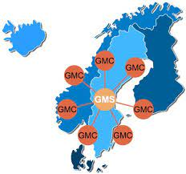
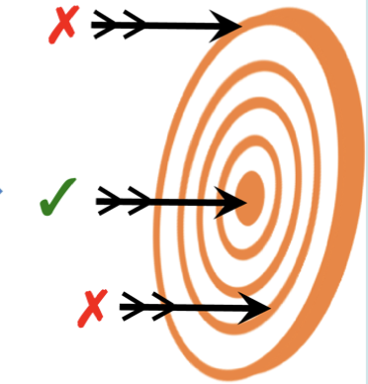
Outline
Introduction
Using PacBio sequencing in patients with chromosomal rearrangements
Using Nanopore to resolve complex duplications in patients with autism spectrum disorder
Clinical applications using adaptive sequencing

Slide 3
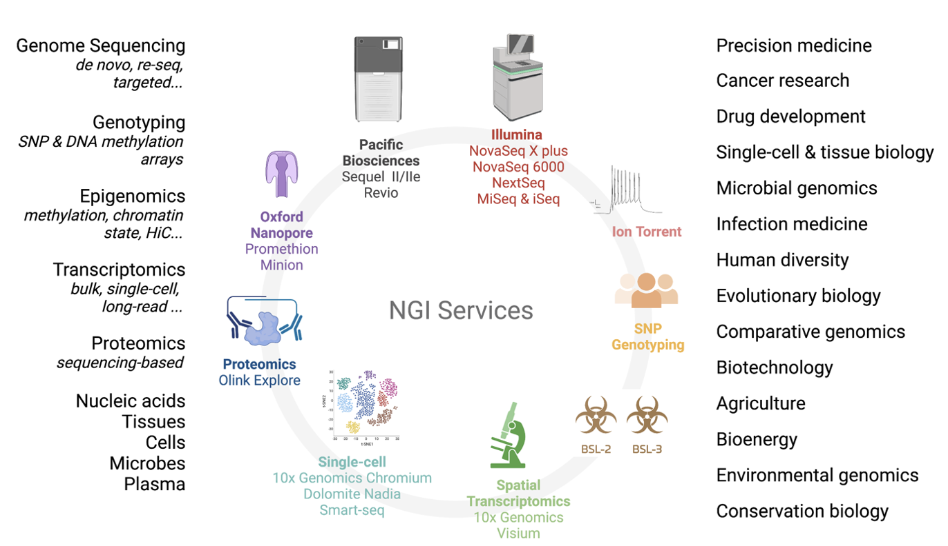
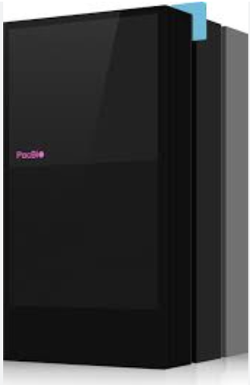
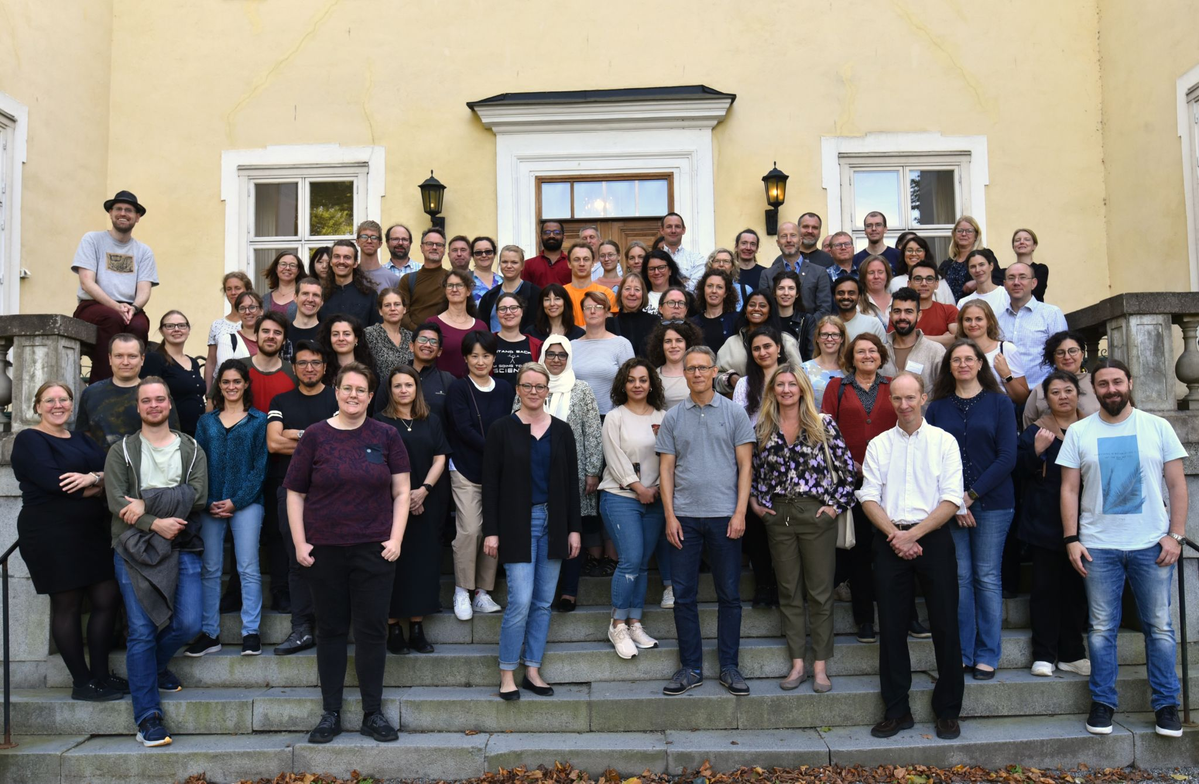
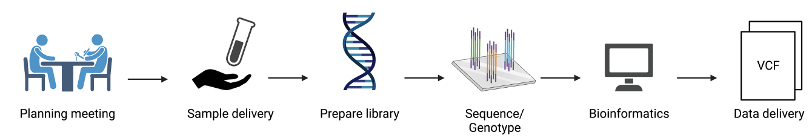
Swedish National Genomics Infrastructure (NGI) at the SciLifeLab Genomics Platform

Slide 4
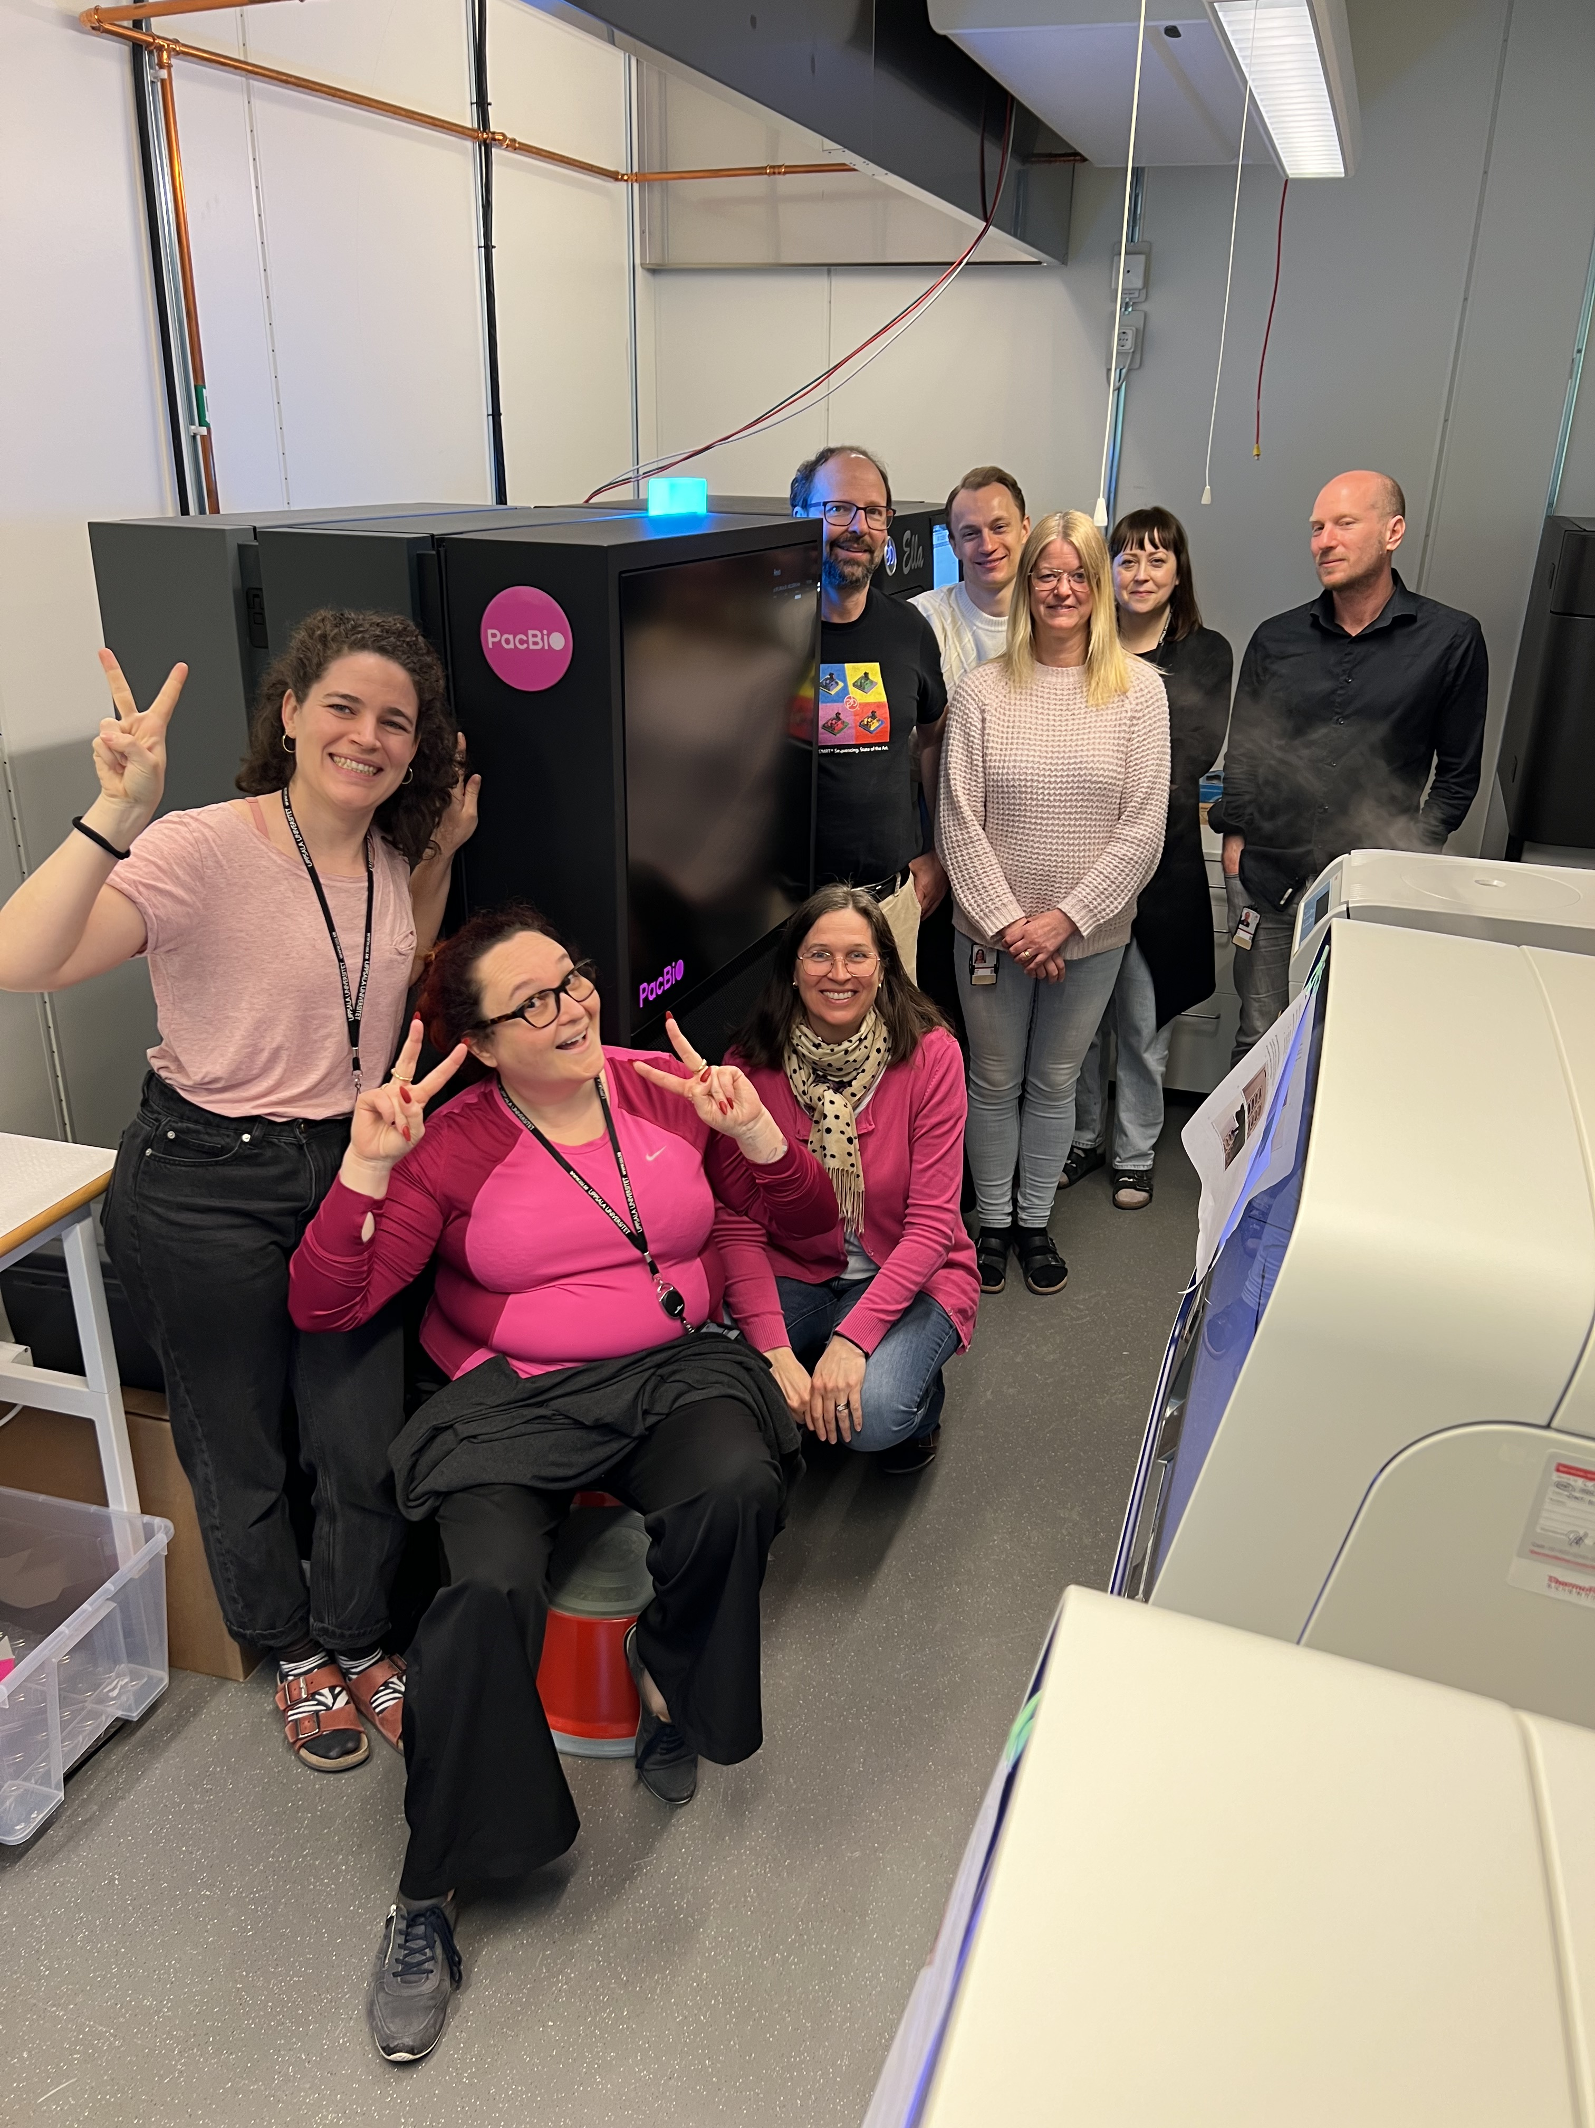
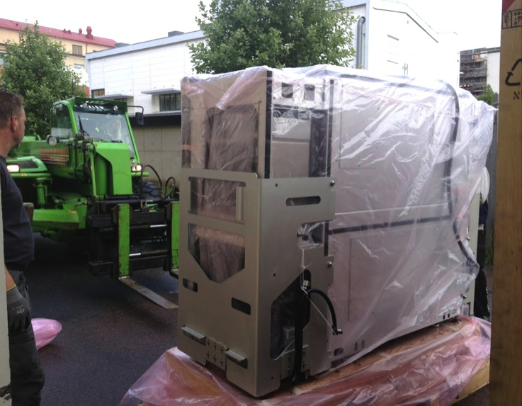
PacBio sequencing at NGI Uppsala
2013: Installation of PacBio RSII
March 2023: Arrival of PacBio Revio
Notes:
4

Slide 5






International collaborations
Human/medical
Find the genetic cause of rare disease
RNA & single-cell
Study isoforms in bulk and single-cell RNA
Biodiversity
Generate reference genome for any species

Slide 6
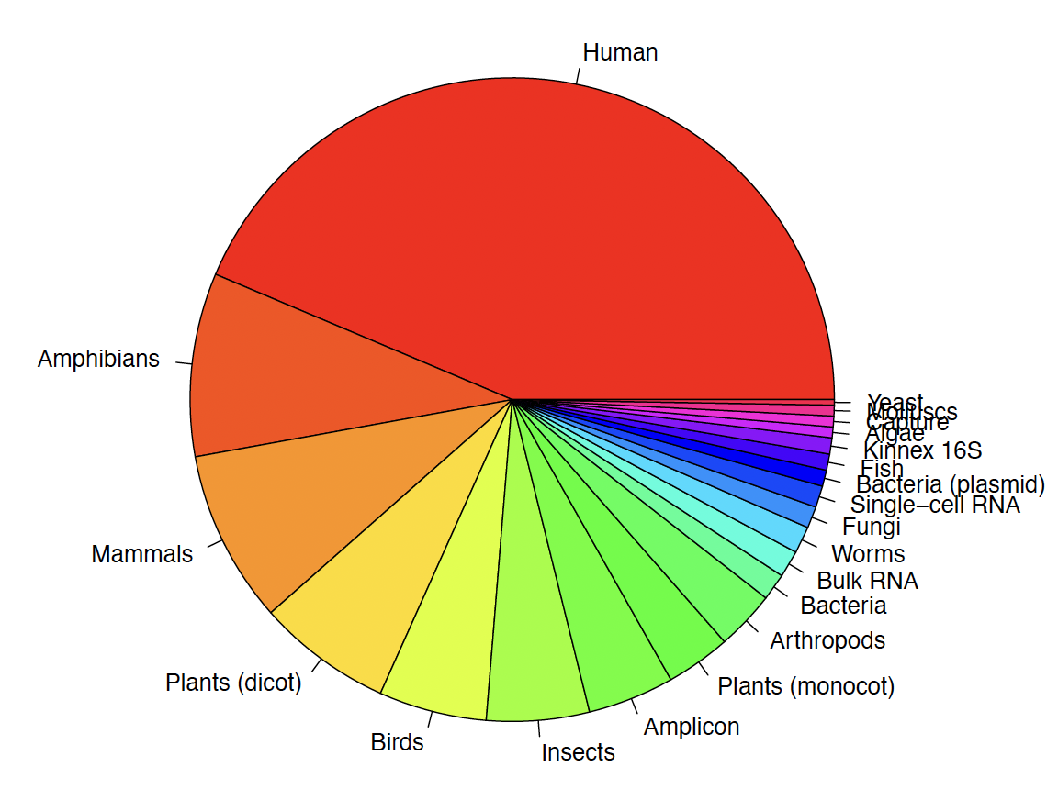
What’s been run on the Revio to date?
374 SMRT cells so far

Slide 7
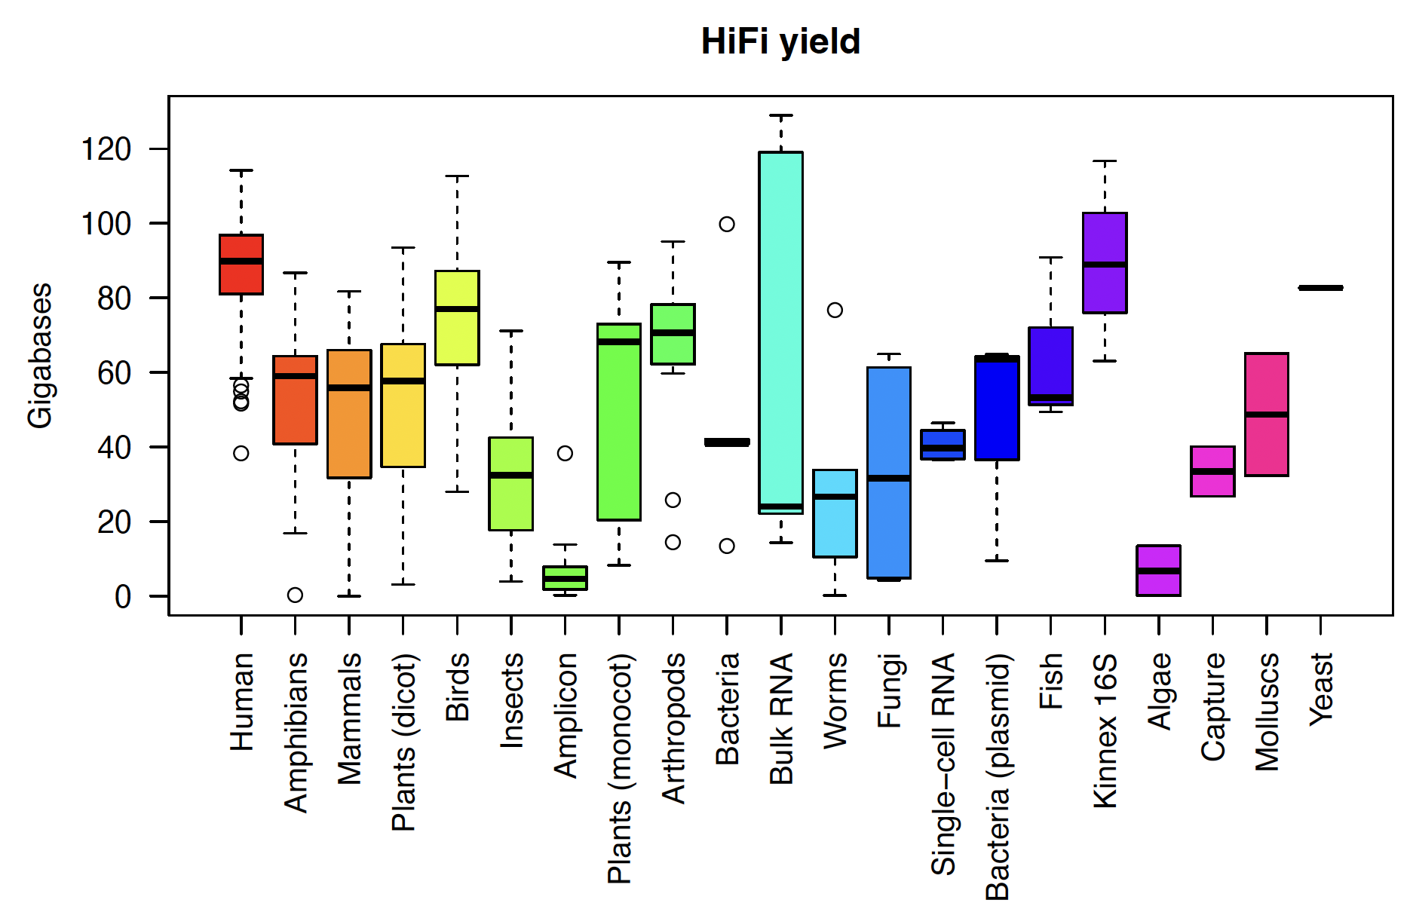
HiFi yield for different sample types

Slide 8
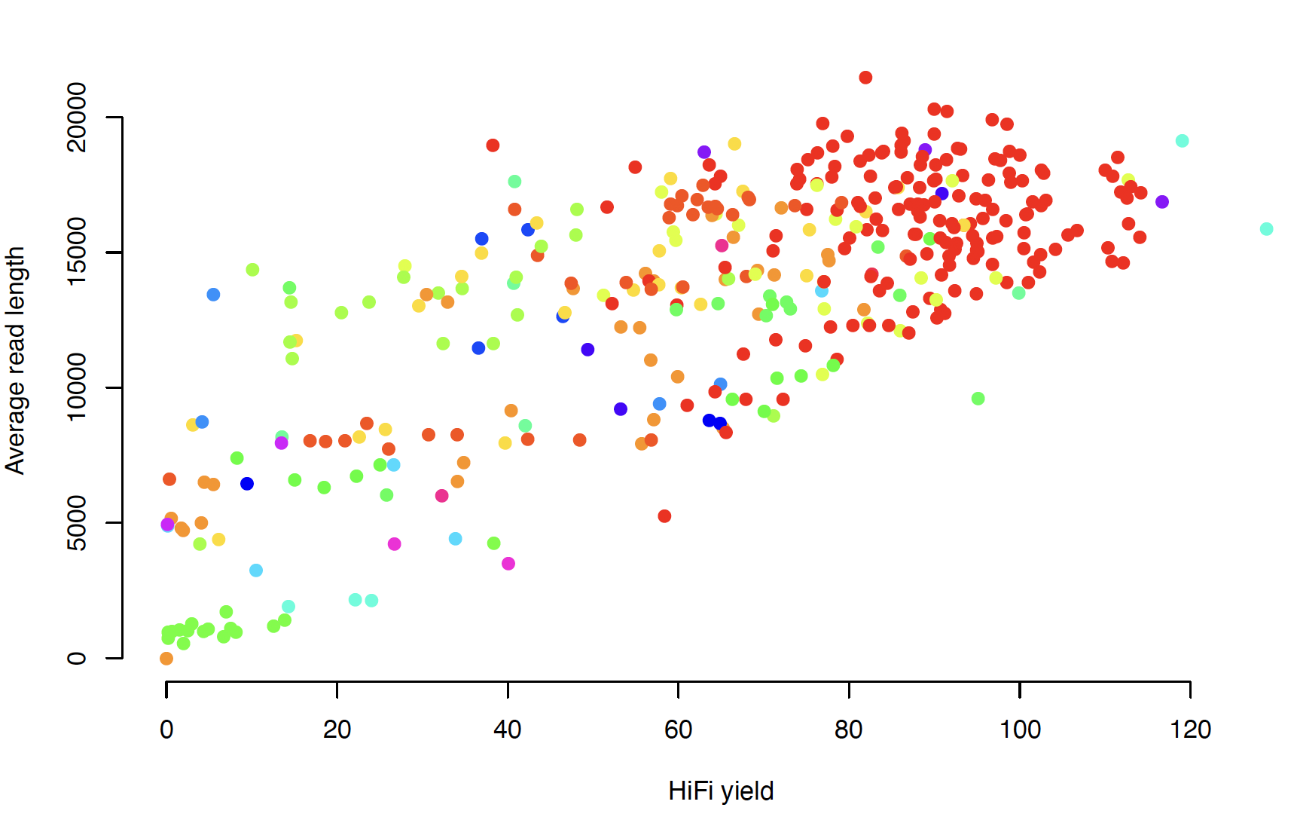
Read length vs Throughput
A complex pattern, also influenced by DNA quality…

Slide 9
Resolving structural variation with long reads
>50% of structural variation (SV) identified by long-read sequencing is not captured by short-read sequencing of the same sample
Long-read sequencing enables nucleotide resolution identification of breakpoints
Accuracy of long read sequencing has improved – can now capture all forms of variation from SNVs to large SVs
Many current diagnostics tests can likely be replaced by long-read sequencing

Slide 10
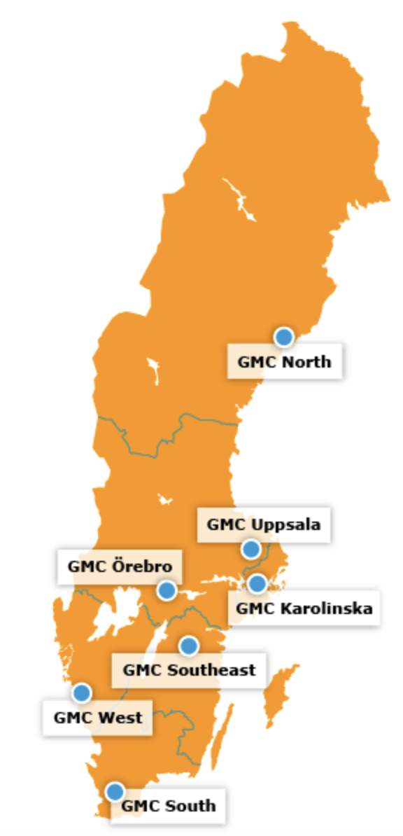

A PacBio Revio pilot on rare disease patients
Collaboration with Genomic Medicine Sweden (GMS)
Project plan:
15-20 samples
From 6 Swedish hospital regions
DNA extracted by regular methods
Complex SVs known or suspected
Other genomics data available (short reads, arrays etc)

Slide 11
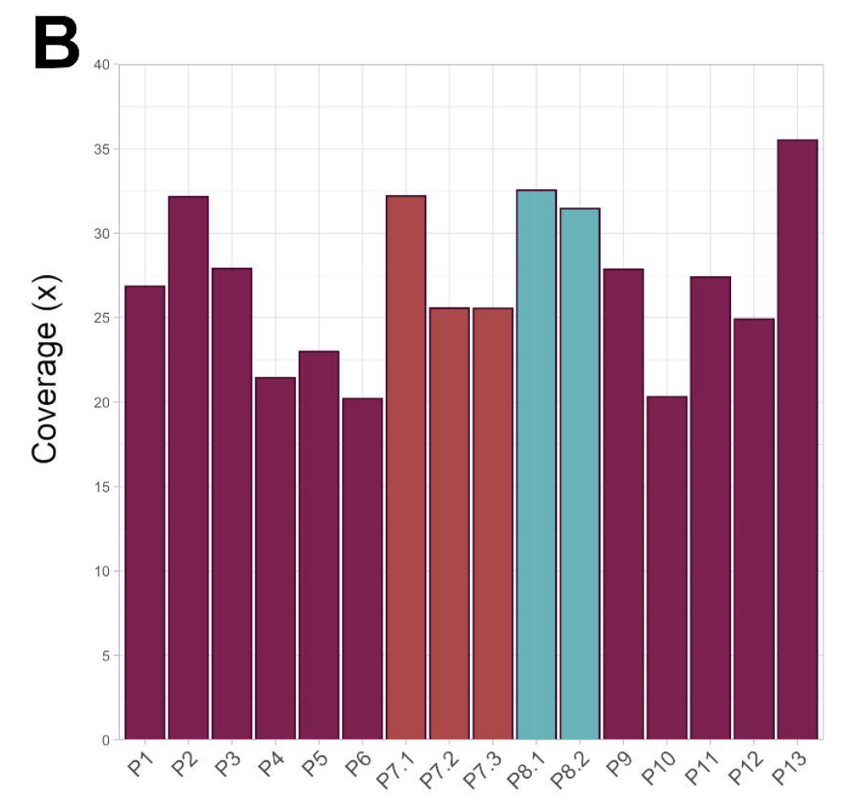
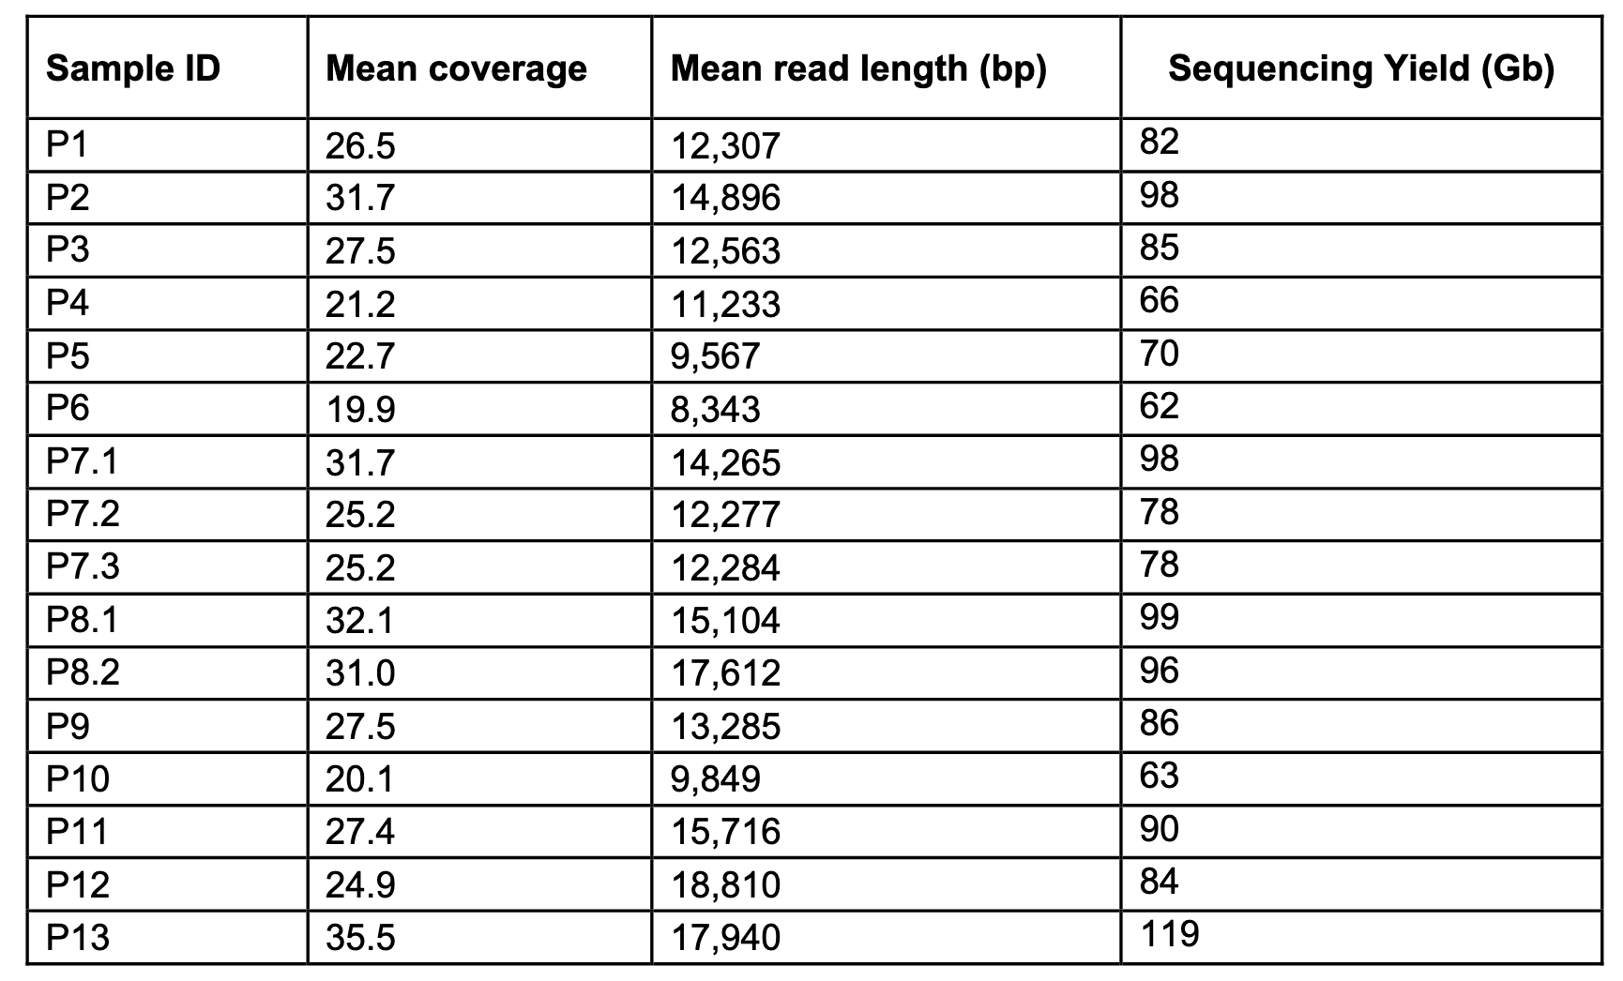
Sequencing stats – regular clinic DNA
Sequenced 16 samples from 13 different families

Slide 12
Results: Variant calling
ID | Small variants (DeepVariant) | Nr reads |  | SVs > 50bp (Sniffles2) |  | Mean coverage
 | SNVs | Insertions | Deletions | Insertions | Deletions | INV/DUP/BND
01 | 4.341M | 411.9k | 412.2k | 12,920 | 9,543 | 172
02 | 4.409M | 416.9k | 426.9k | 13,182 | 9,517 | 156
03 | 4.369M | 413.1k | 423.9k | 13,041 | 9,633 | 177
04 | 4.322M | 407.9k | 396.1k | 12,846 | 9,320 | 188
05 | 4.341M | 412.4k | 405.5k | 12,891 | 9,425 | 212
06 | 4.356M | 405.4k | 414.8k | 12,794 | 9,576 | 268
07 | 4.389M | 419.9k | 423.8k | 13,331 | 9,543 | 181
08 | 4.348M | 407.4k | 419.7k | 13,094 | 9,595 | 195
09 | 4.381M | 414.7k | 408.7k | 13,131 | 9,478 | 187
10 | 4.422M | 418.1k | 427.0k | 13,071 | 9,444 | 163
11 | 4.420M | 415.3k | 422.1k | 13,135 | 9,488 | 145
12 | 4.409M | 415.1k | 427.5k | 13,083 | 9,535 | 139
13 | 4.358M | 408.4k | 397.7k | 12,801 | 9,481 | 209
14 | 4.406M | 411.8k | 421.6k | 12,940 | 9,474 | 179
Average | 4.377M | 412.7k | 416.3k | 13,019 | 9,504 | 184

Slide 13
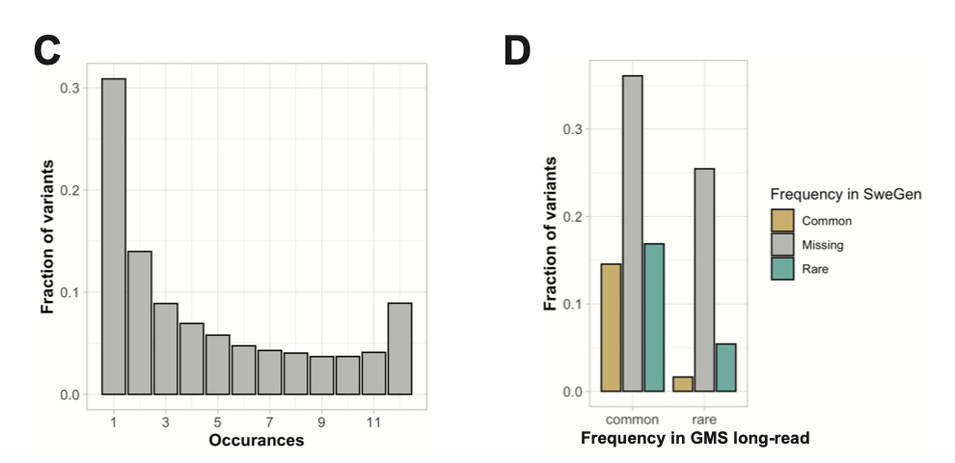

Comparison to short-read SVs
SweGen: 1000 Swedish individuals sequenced with Illumina WGS
70% of PacBio SVs are not present in the SweGen database

Slide 14
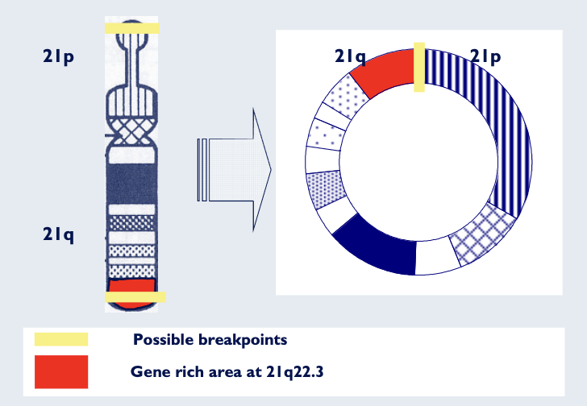
Results from pilot study
14/16 unique rearrangement were resolved
13 with nucleotide resolution breakpoints, one only with read-depth analysis
Several rearrangements were more complex than expected
Unresolved cases:
Gain on short arm of chr21 identified by karyotype (not seen on array)
Mosaic ring chromosome 21: 46,XY,r(21)(p11q22)[9]/46,XY,del(21)(q22.3)[4]/46,XY[12]

Slide 15
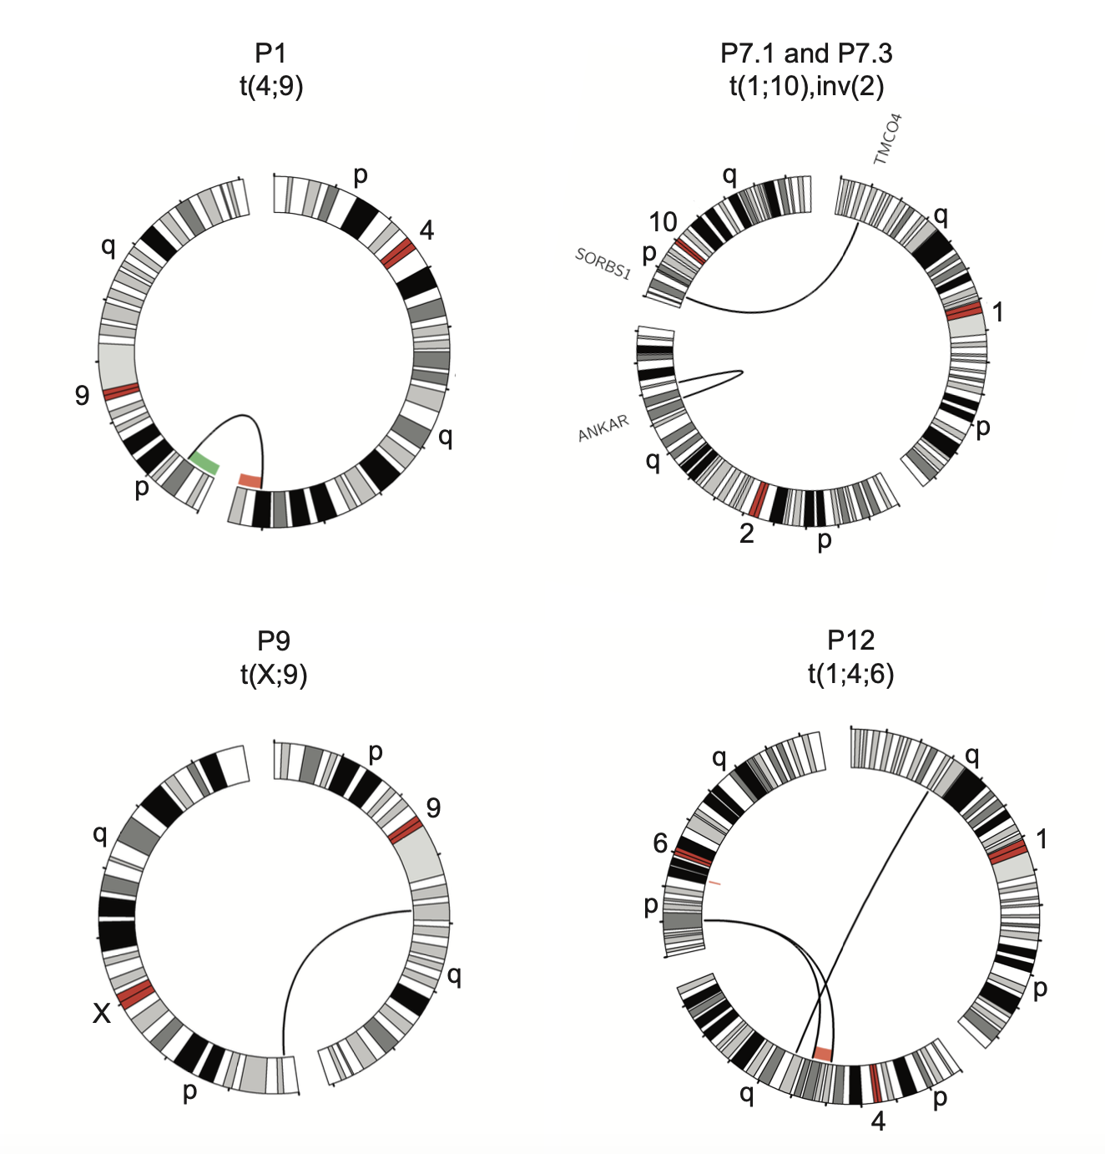
Translocations and inversions
All resolved at nucleotide resolution
Patient 9: Could only be correctly mapped using T2T
Chr9 breakpoint region missing in GRCh38
P12: The analysis detected four breakpoint junctions (BPJs), a 13.8 MB deletion on chromosome 4 as well as an independent 1.2 MB deletion on chromosome 6

Slide 16
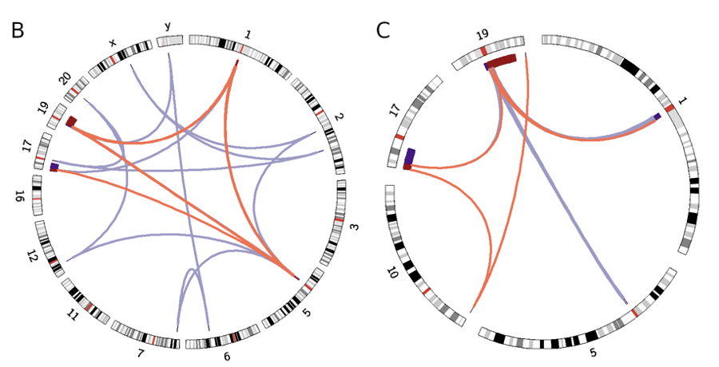
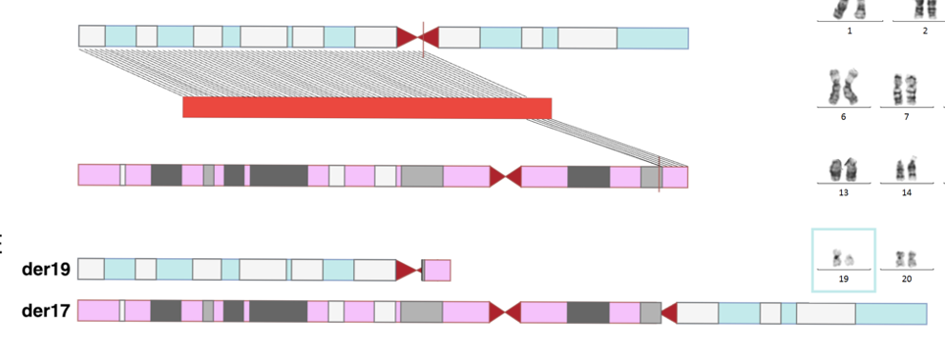
Resolution of centromeric rearrangements using T2T
Karyotype 46,XY,t(17;19) (p13;p11)
Congenital cataract of the left eye, epileptic seizures and high-functioning autism
Not resolved using short-read sequencing or with optical genome mapping
Resolved at nucleotide resolution on both chromosomes
GRCh38
T2T

Slide 17
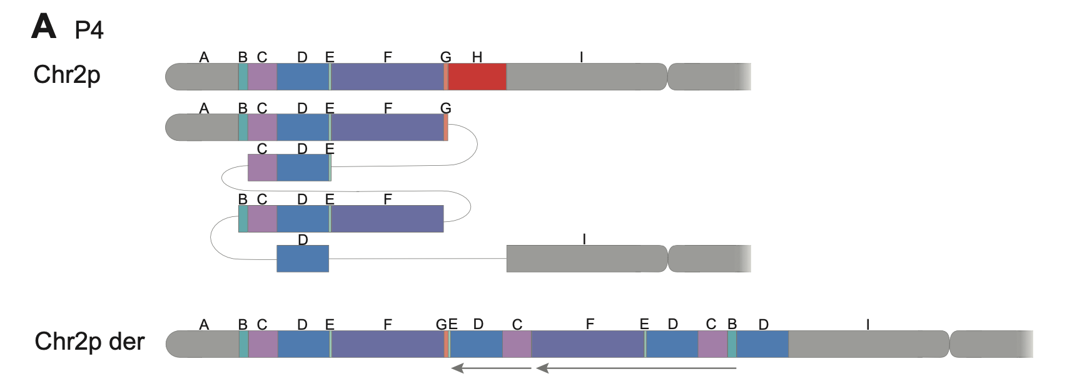
Examples of complex rearrangements
Patient with congenital craniofacial syndrome
Array analysis called two duplications and one deletion
Fully resolved DUP-TRIP-QUAD-TRIP-DUP-DEL and a separate DEL-INV-DEL

Slide 18
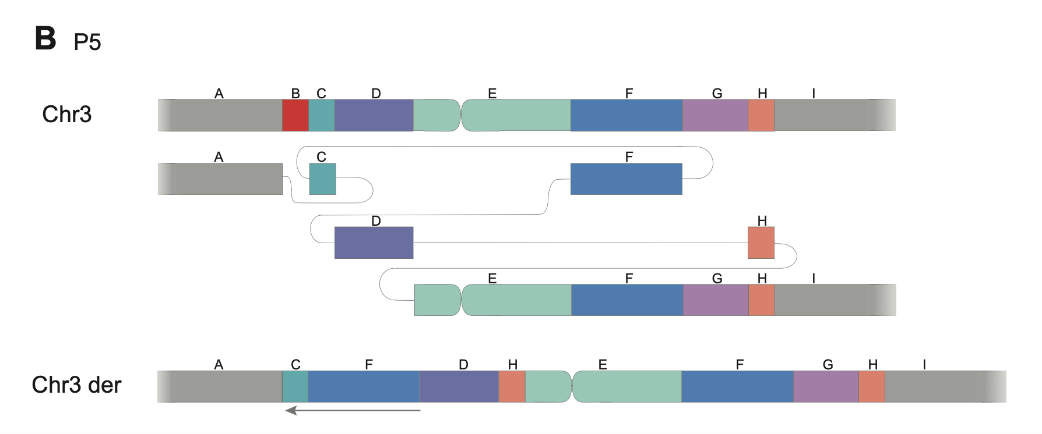
Examples of complex rearrangements
Proband with developmental delay
Array called a deletion and a duplication
Resolved as DEL-INV-NML-DUP-NML-DUP

Slide 19

Next phase of Genomic Medicine Sweden project
Focus on undiagnosed disease patients
Phase 1 – 55 patients (+srWGS trios, RNAseq, Methylation)
Phase 2 >100 patients
Addition of parents/siblings for a subset of individuals
Joint analysis pipeline across all sites
Hackathons and meetings to understand rare disease cases

Slide 20
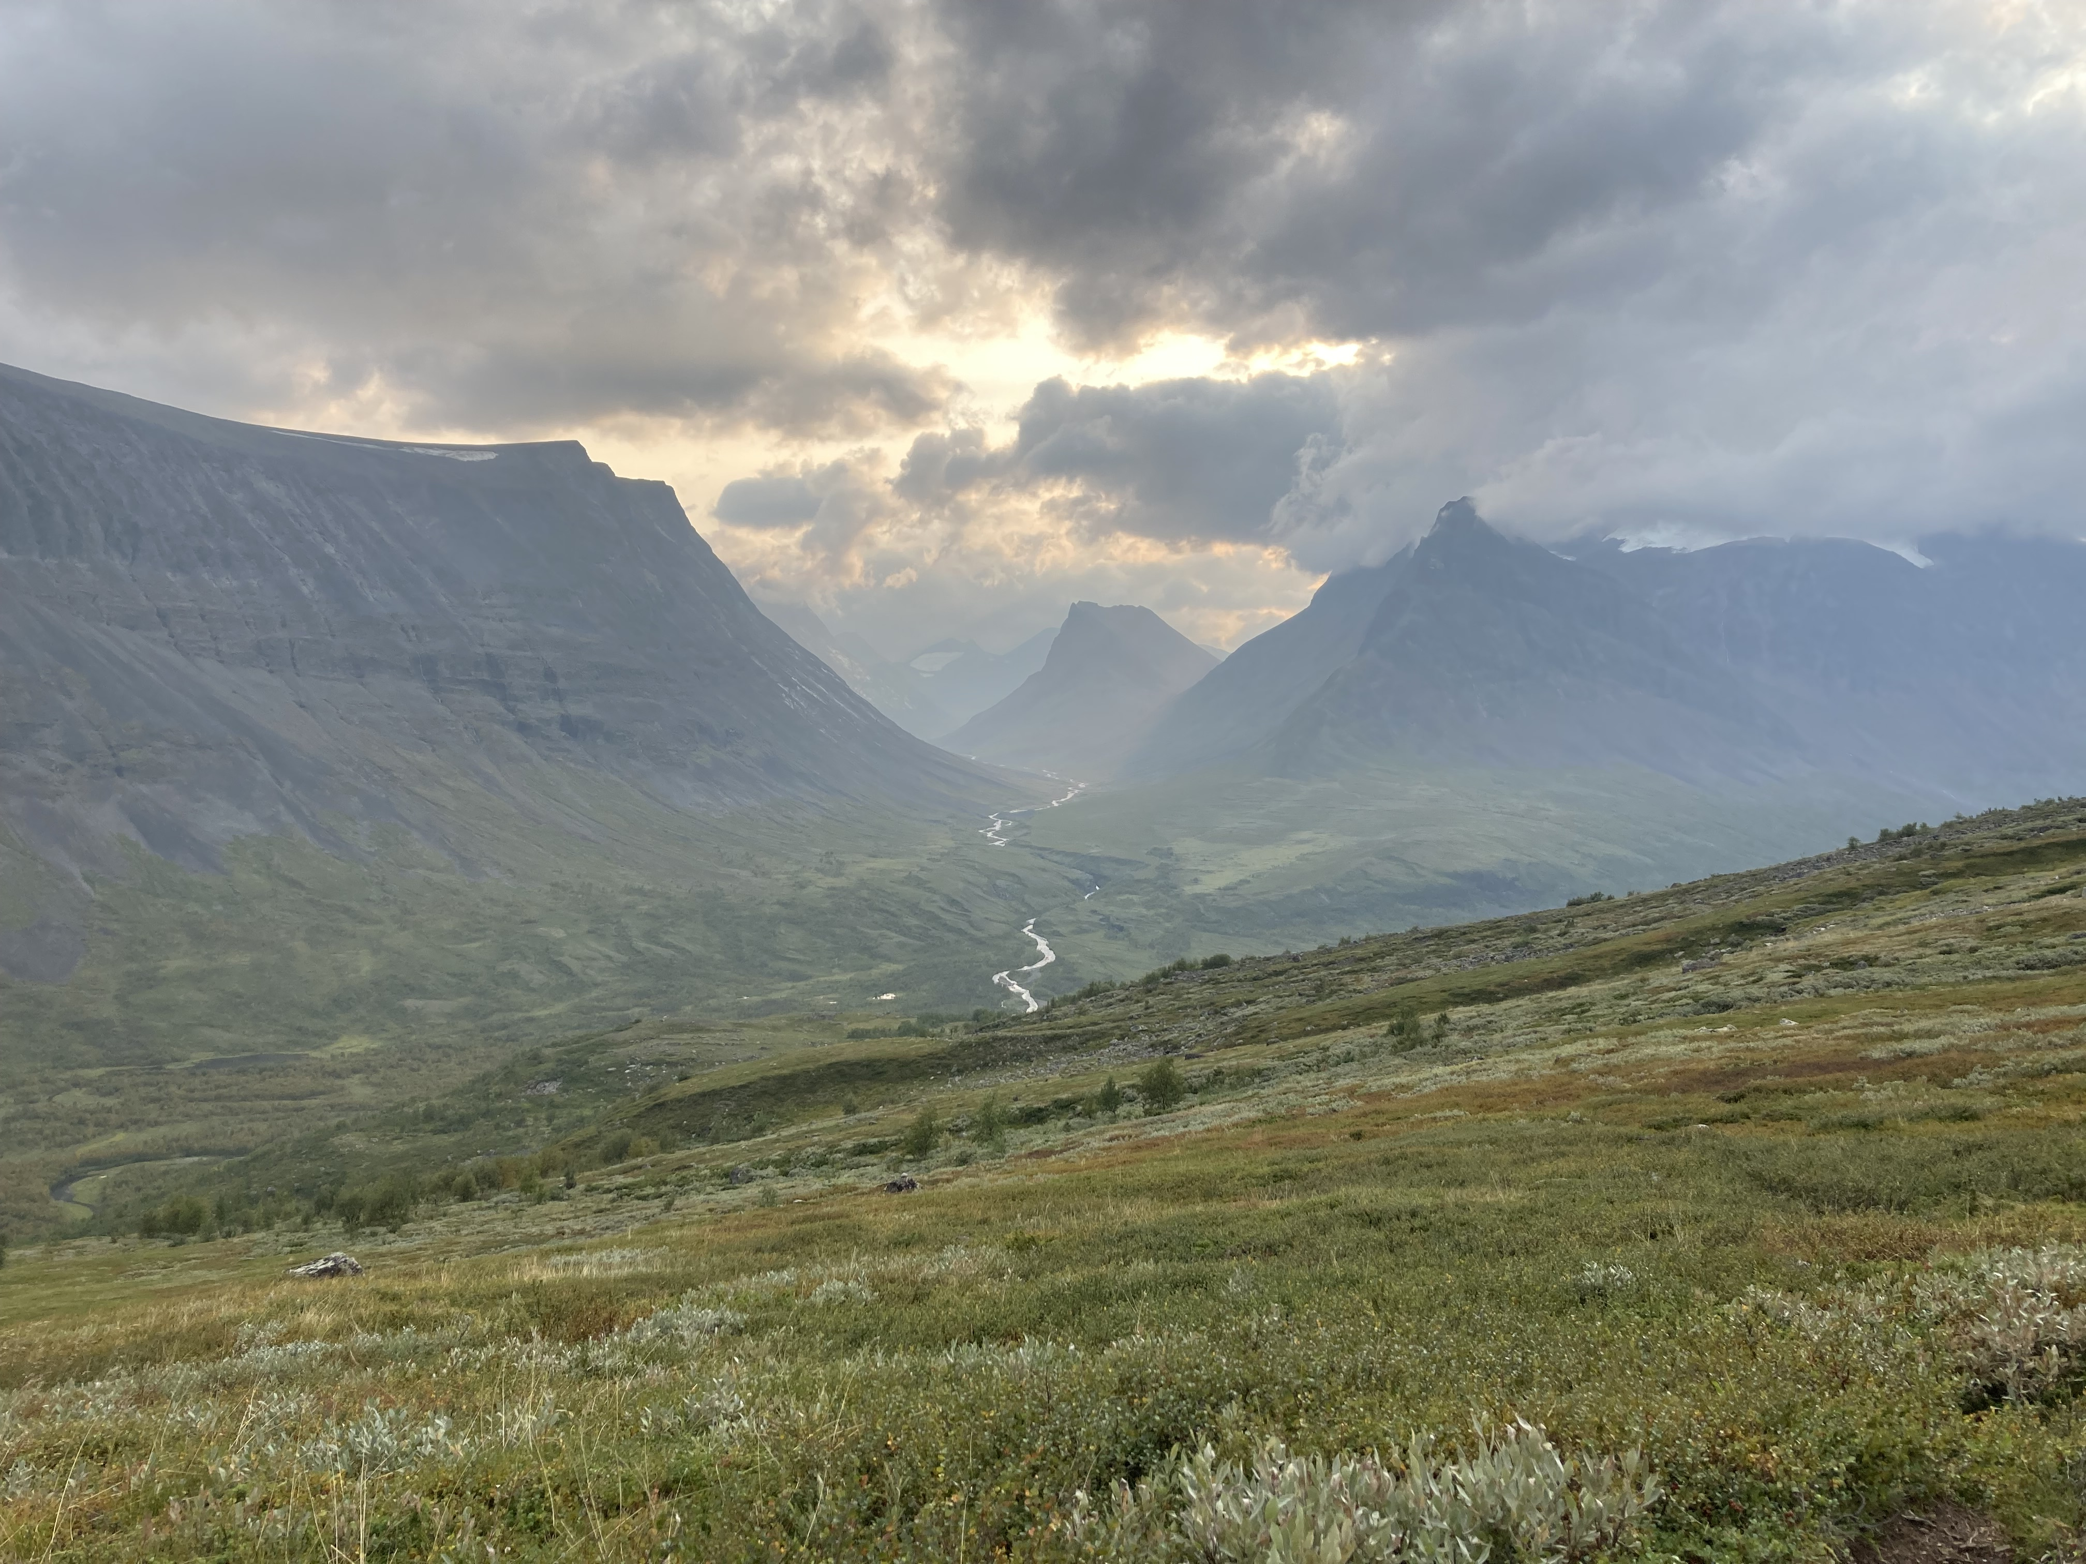
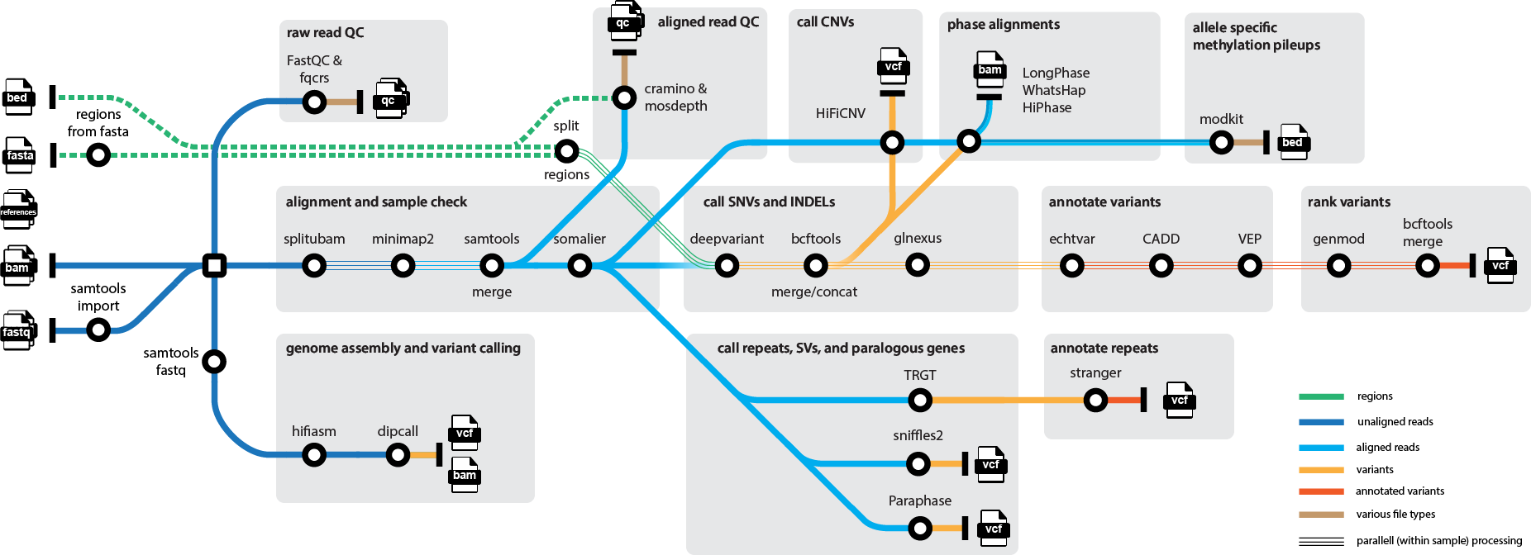

Genomic-Medicine-Sweden/Nallo
A long-read analysis pipeline developed for both PacBio and (targeted) ONT data
Aims to be easy to set up and run in different locations and environments (including offline)
Written in Nextflow using the nf-core template, available on GitHub at genomic-medicine-sweden/nallo
Developed by Felix Lenner

Slide 21
Genomic-Medicine-Sweden/Nallo

Slide 22
Investigating families with large duplications
Family 1
Family 2
Family 3
*
*
*
*
*
*
*
*
*
*
*
Family 4
Family 5
*
*
*
*
*
*carrier of complex rearrangement
Families were selected in collaboration with Stephen Scherer from the Autism Speaks MSSNG project
At least one individual with autism spectrum disorder diagnosis
Complex rearrangements involving large duplications as assessed by short-read sequencing
Can long-read sequencing be used to resolve these rearrangements without use of previous data?

Slide 23
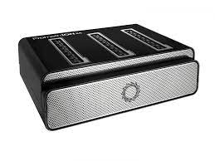
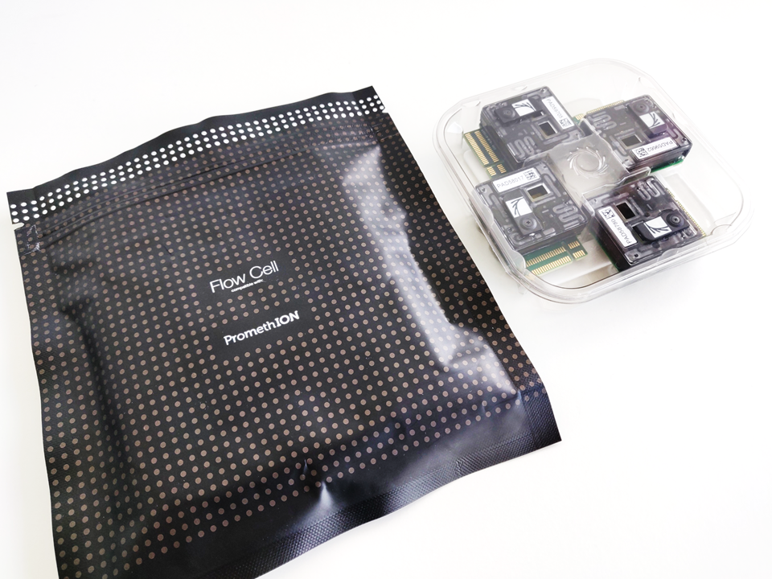
Whole genome nanopore sequencing
Families were selected for nanopore PromethION sequencing
One PromethION flowcell per individual for a total of 20 samples
Coverage 25-40X
Mean read length 12kb

Slide 24
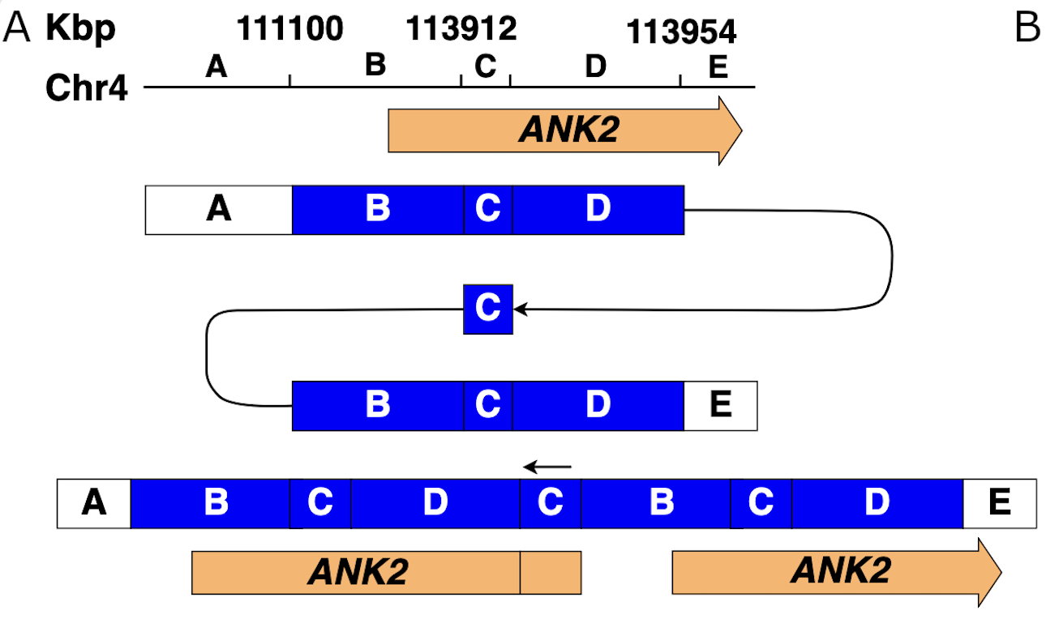
Families with rearrangements - results
Family 1
Family 2
*
*
*
*
*
*
2.85 Mb DUP-TRP-DUP overlapping 12 genes
Exactly the same breakpoints in the two families – mutation signature indicates recent founder variant

Slide 25
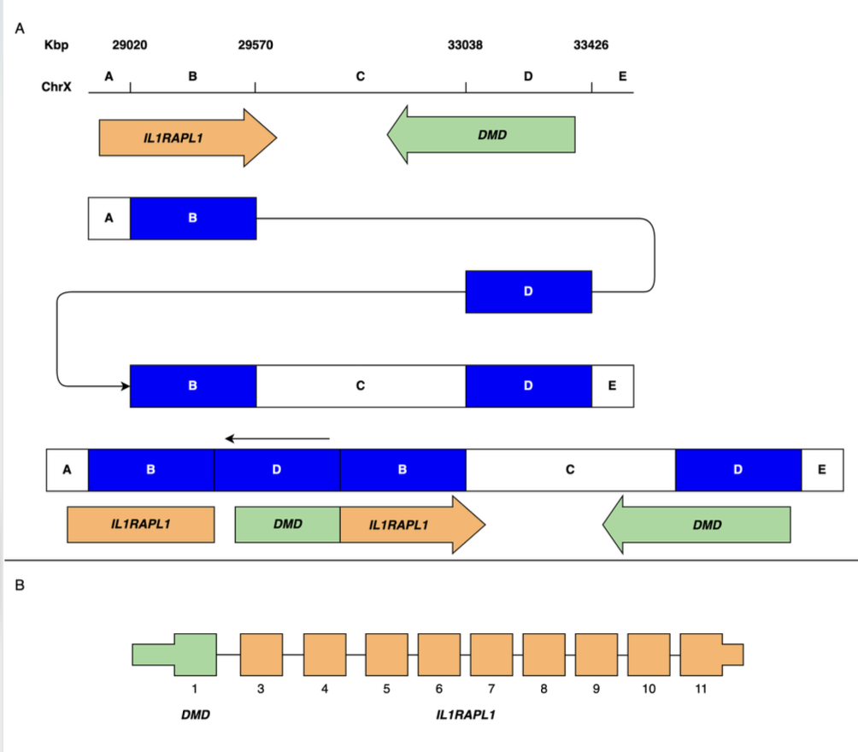
Chromosome X rearrangement
Rearrangement creates potential for an in frame DMD/IL1RAPL1 fusion transcripts
Disruption of only IL1RAPL1 has also been linked to intellectual developmental disorders
Family 3
*
*
*
*
*

Slide 26
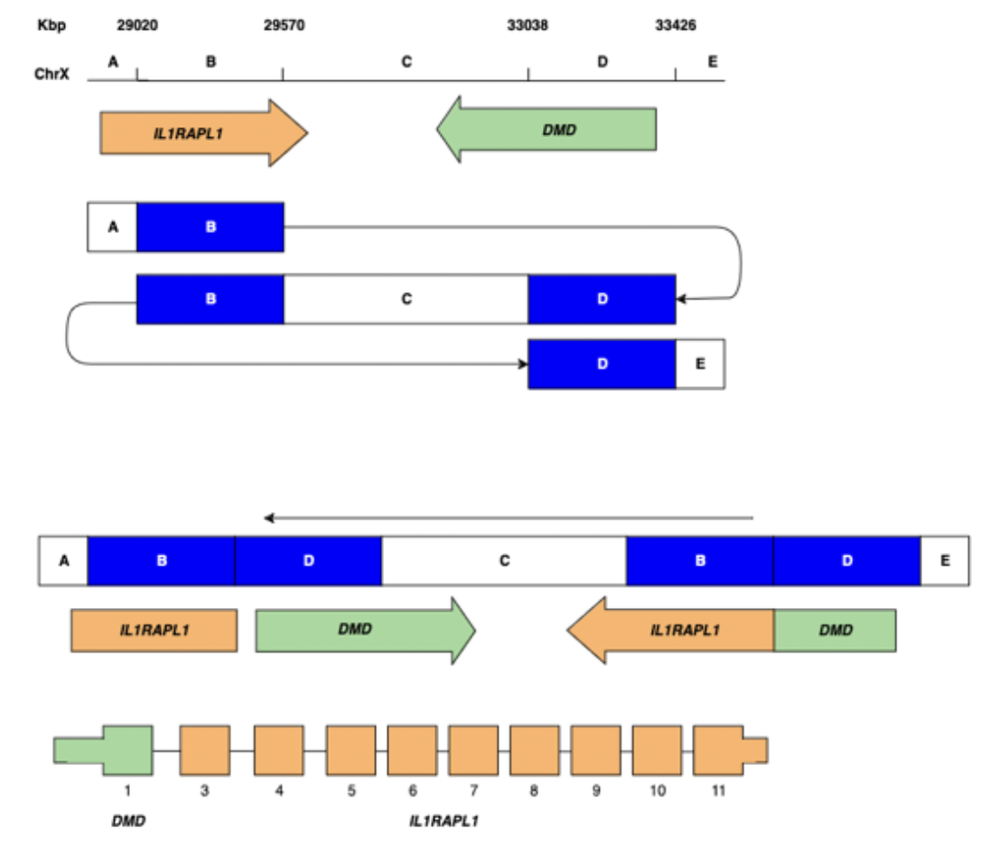
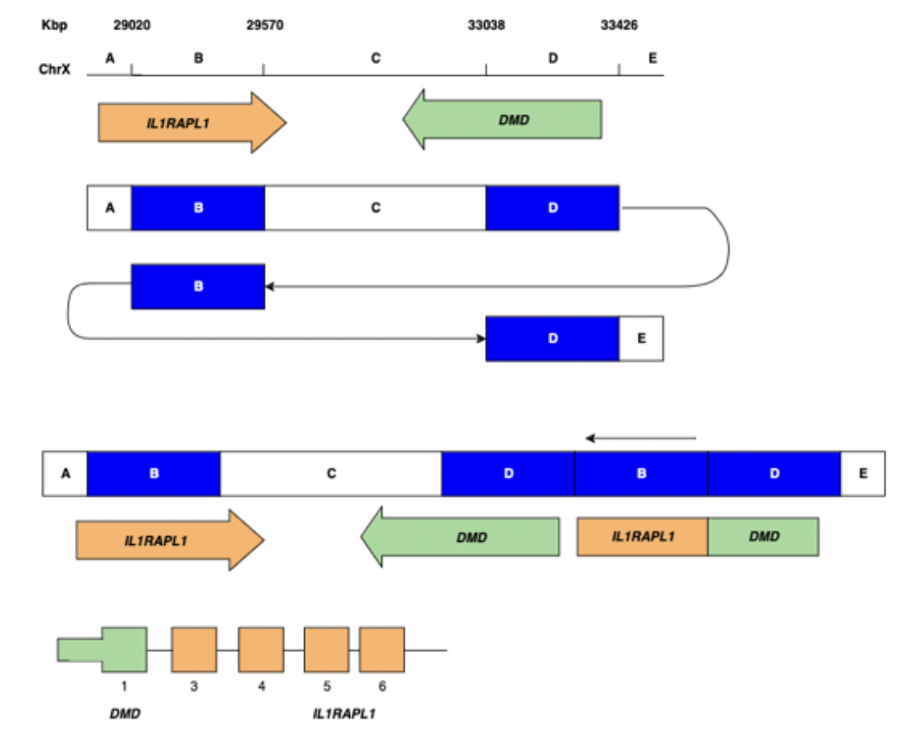
Alternative solutions to architecture

Slide 27
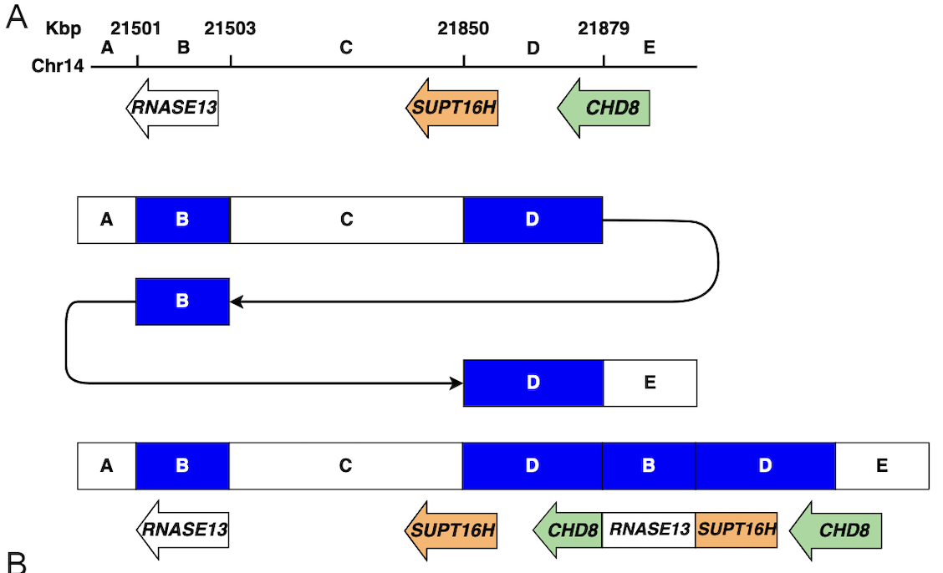
Families with rearrangements - results
Family 4
*
*
*
Duplication creates potential for an in frame fusion transcript between SUPT16H+RNASE13+CHD8

Slide 28
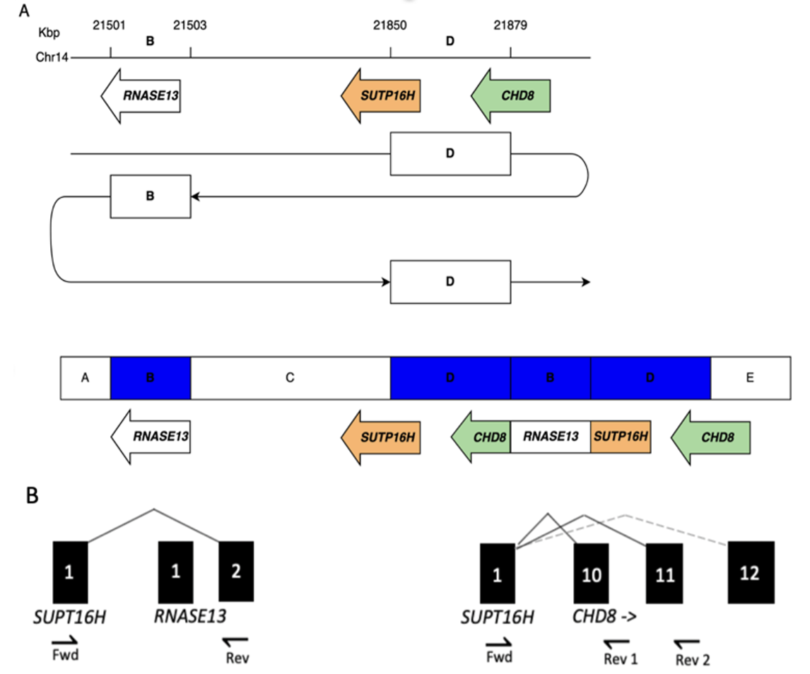
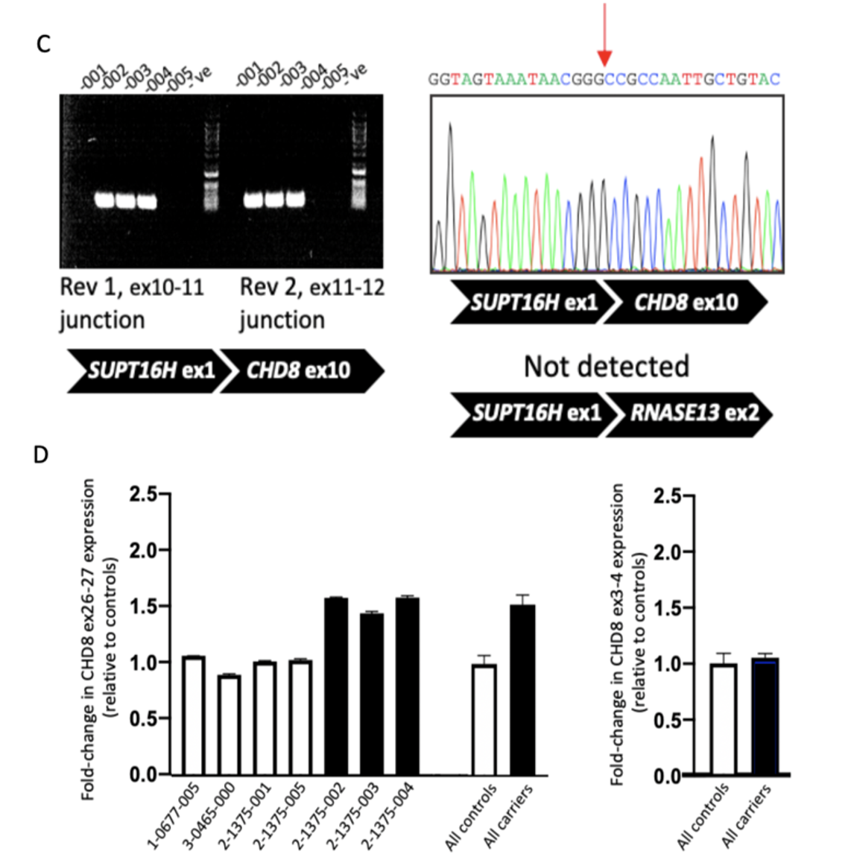
Families with rearrangements - results
Fusion transcript validation

Slide 29
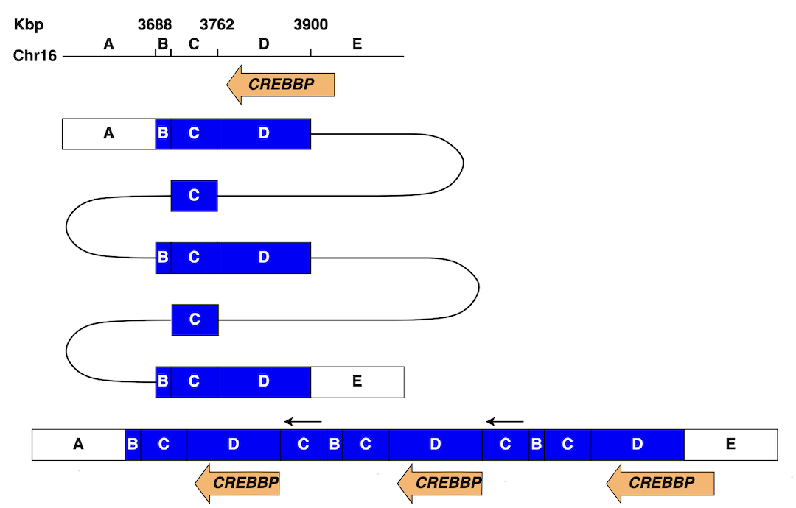
Families with rearrangements - results
Family 5
*
*
TRIP-QUINT-TRIP involving CREBBP
Duplications of CREBBP previously associated with ASD

Slide 30
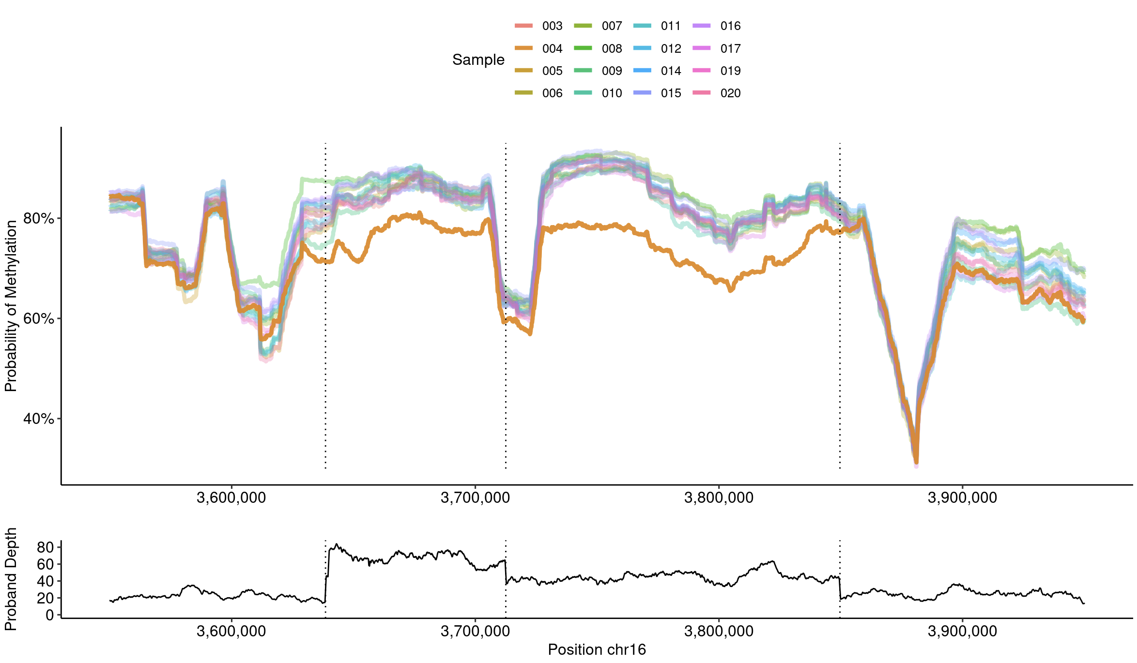
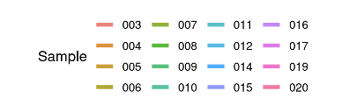
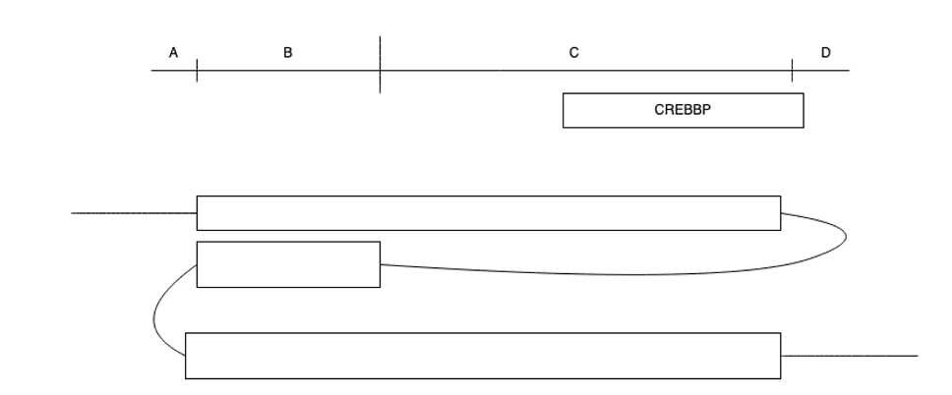
Methylation analysis in relation to rearrangements
Proband (orange) vs controls

Slide 31
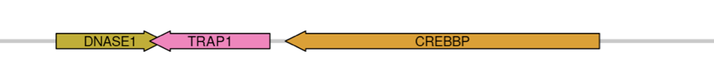
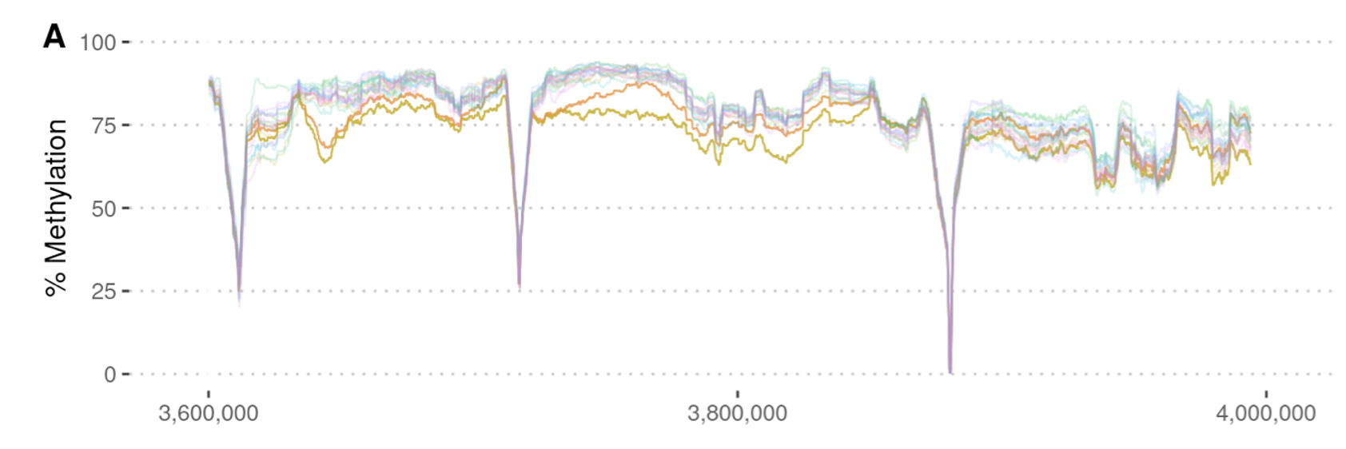
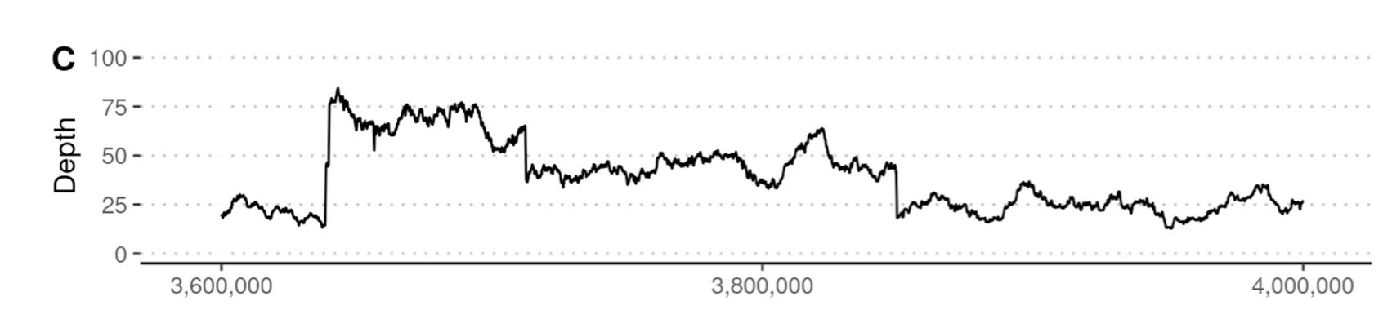
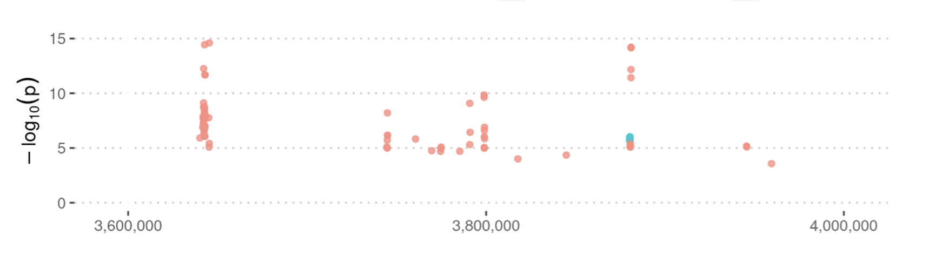
Methylation analysis – an additional layer of information
Percentage of reads showing methylation (mean value across 200 CpG sites).
Proband (yellow), Father (orange).
Rearrangement region
Sequence read depth across region
Differentially methylated regions
Proband vs controls

Slide 32
Conclusions from nanopore pilot
All breakpoints could be mapped at nucleotide resolution
One rearrangement with 3 possible solutions
Oxford nanopore works well for resolving complex structural variation
Two rearrangements give rise to (potential) fusion transcripts
The role of fusions in pathogenesis of rare disease is not well explored
Methylation information may provide further insight into the effect of the rearrangement

Slide 33
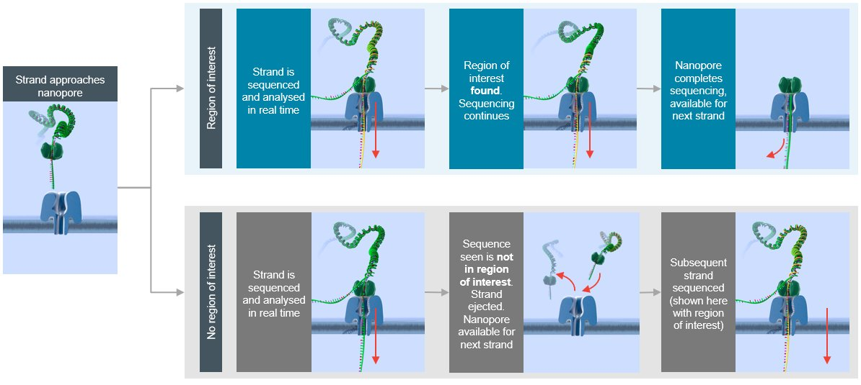
Adaptive sequencing
Target in Region of Interest (ROI)
Sequencing continues
Provide reference file with targets
Each fragment being sequenced in compared in real time
Match -> sequencing continues
No match -> fragment ejected
Reject when not in ROI
Figure modified from www.nanopore.com

Slide 34
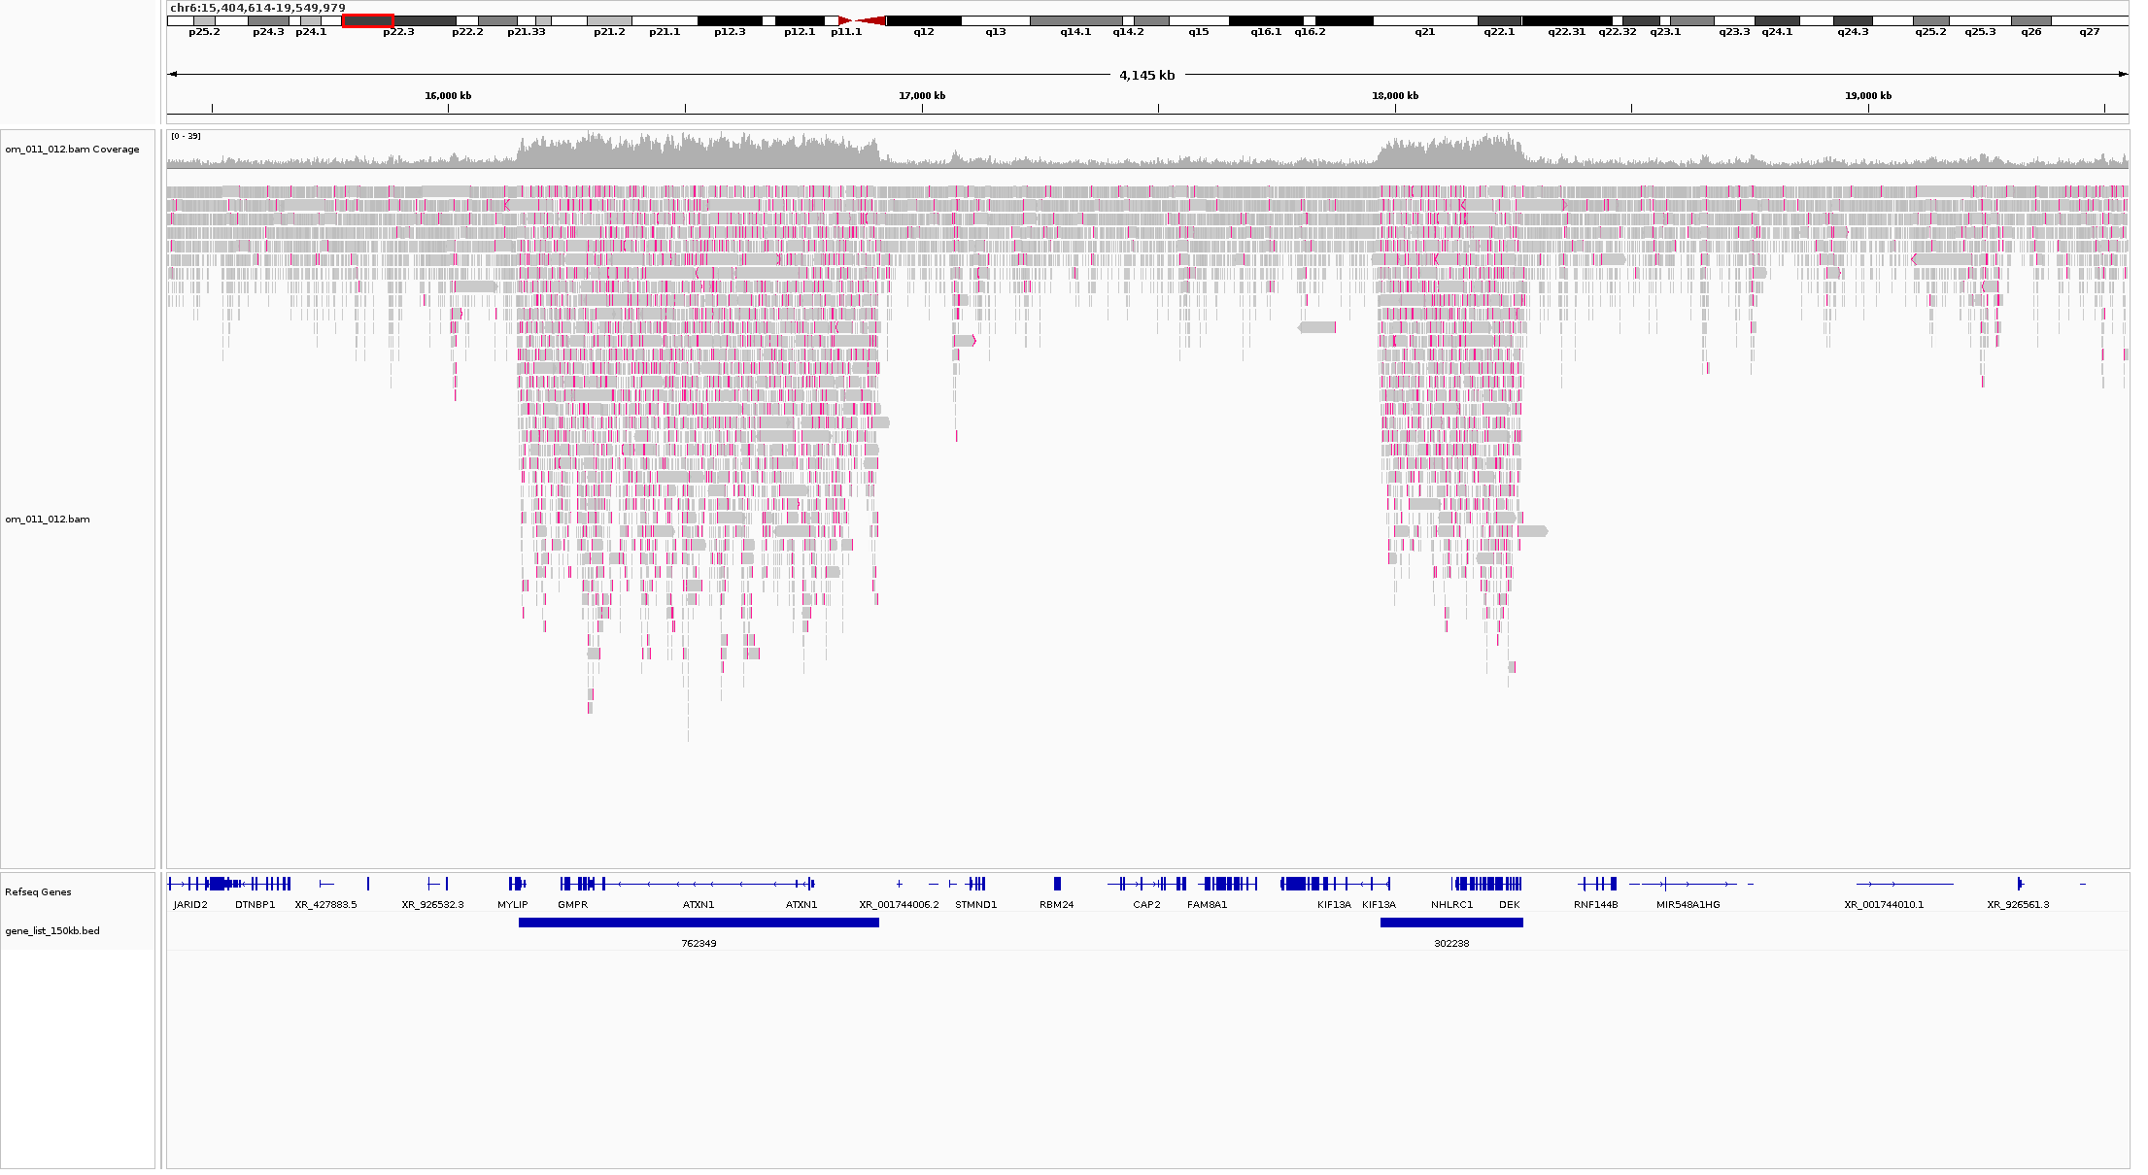
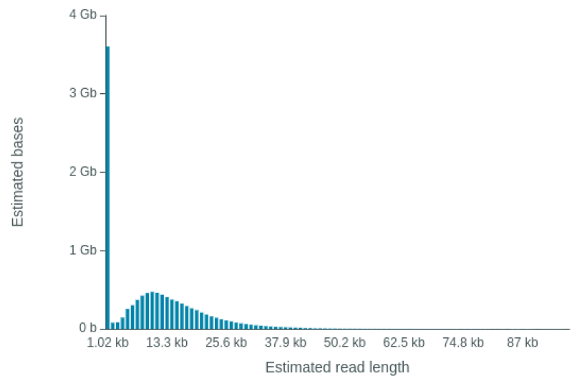
”In silico” enrichment of any target
Reads from ejected fragments
Reads from enriched regions
Provides long-read data with methylation information across targeted regions

Slide 35
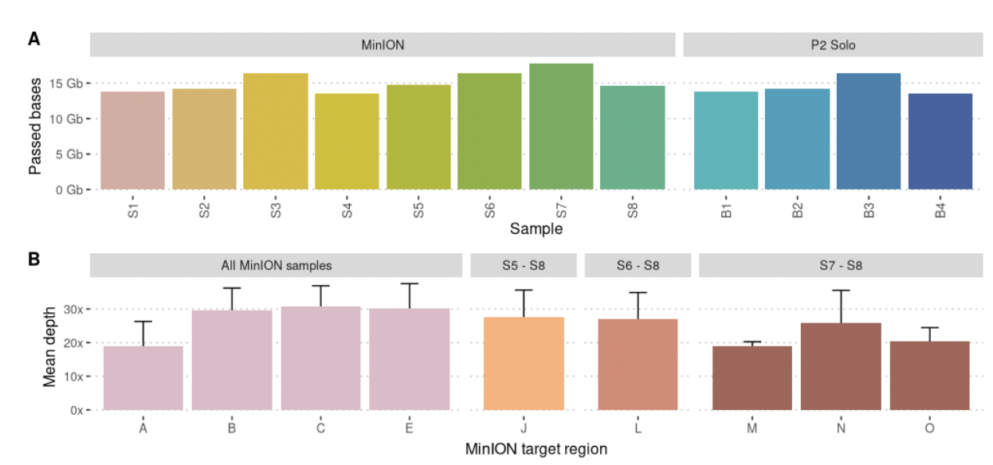
Validation of structural variation
Target Region | Coordinates | Variant type | Size | Platform
A | chrX:27,000,000-36,000,000 | Complex | 9 Mb | MinION+P2S
B | chr14:20,000,000-22,500,000 | Complex | 2.5 Mb | MinION+P2S
C | chr16:2,500,000-5,000,000 | Complex | 2.5 Mb | MinION+P2S
E | chr4:108,000,000-115,000,000 | Complex | 7 Mb | MinION
J | chr6:96,600,000-97,300,000 | Deletion | 700 Kb | MinION
K | chr6:95,868,323-96,766,693 (T2T-CHM13) | Translocation | 898 kb | MinION
L | chr17:4,825,565-4,925,565 | Translocation | 100 Kb | MinION
M | chr4:181,364,917-181,464,917 | Translocation | 100 Kb | MinION+P2S
N | chr9:12,993,905-13,093,905 | Translocation | 100 Kb | MinION+P2S
O | chr16:28,242,001-29,708,000 | Deletion | 1.47 Mb | MinION

Slide 36
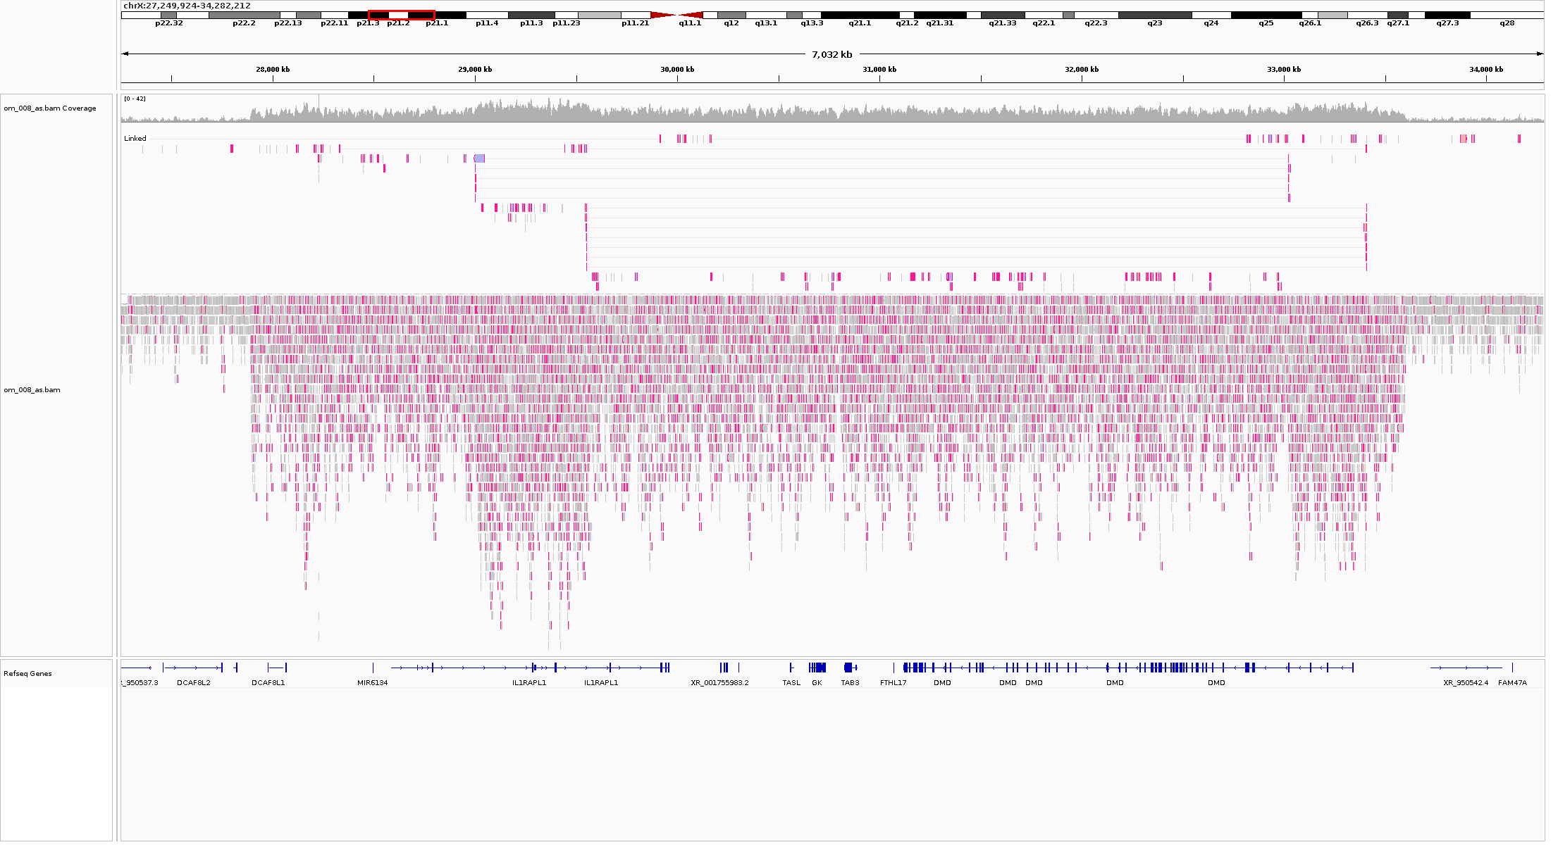
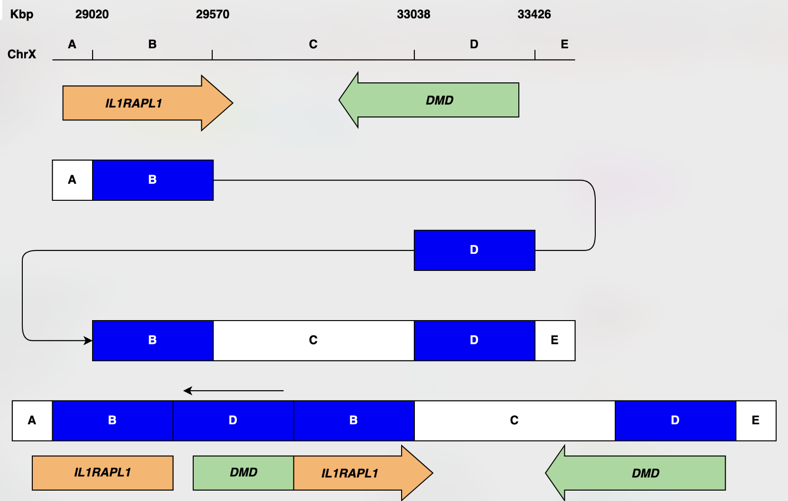
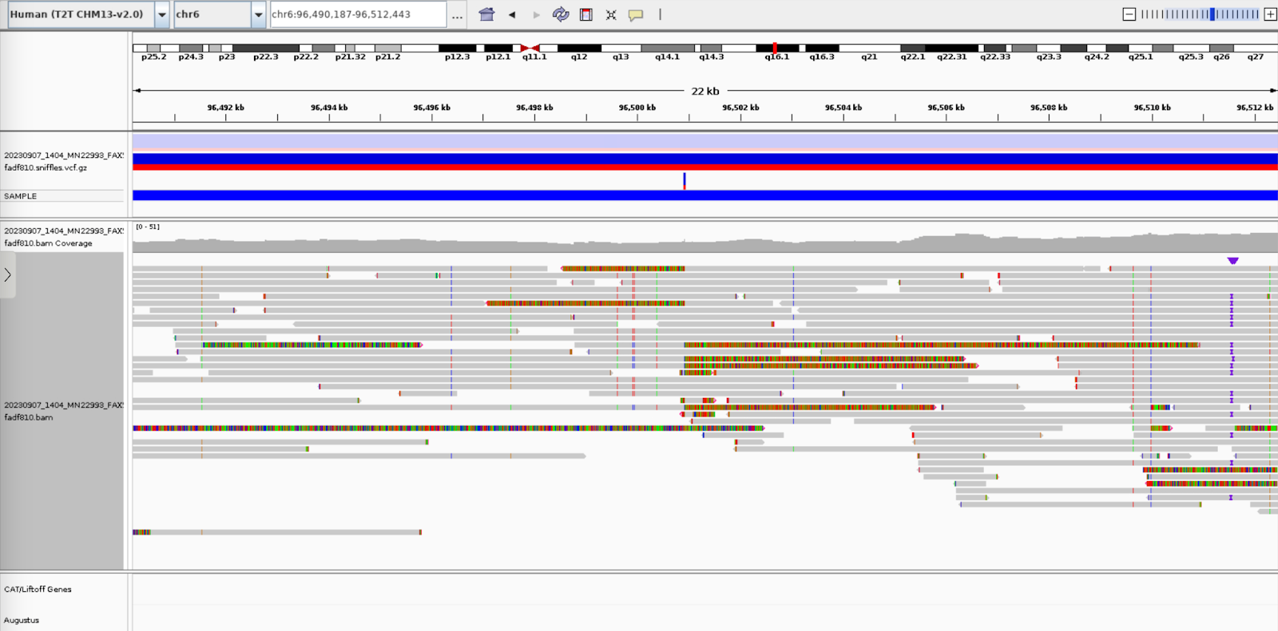
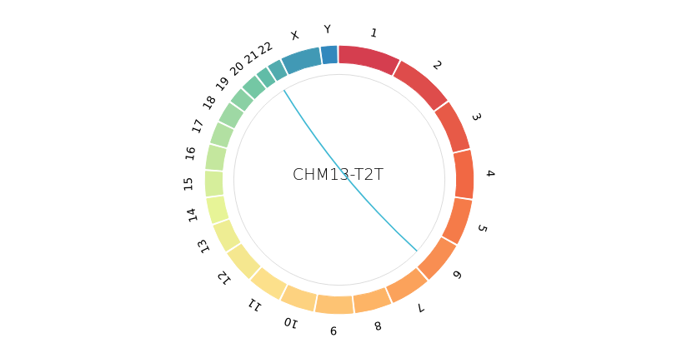
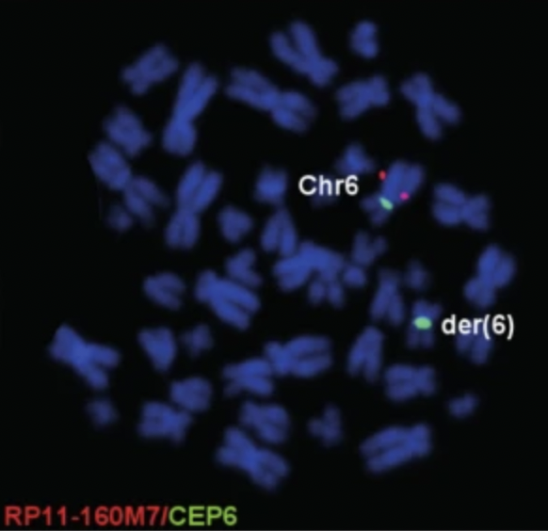
Resolving and validating complex rearrangements
Example 1:
Complex chr X rearrangement
Example 2:
Previously unmappable translocation
Breakpoints in assembly gap on chr6 and short arm of chr22

Slide 37
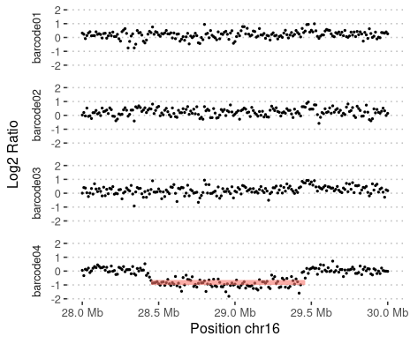

Off-target reads can be used for CNV analysis

Slide 38

Panel sequencing with adaptive sampling
Targeting 127 genes, including 18 repeat regions
1 sample per minION flowcell or 3-4 samples per PromethION flow cell

Slide 39

Panel sequencing with adaptive sampling

Slide 40

Panel sequencing with adaptive sampling

Slide 41

Panel sequencing with adaptive sampling

Slide 42

Coverage across 127 genes

Slide 43




Repeat regions
RFC1
RFC1
ATXN10
ARX

Slide 44

Gene panel adaptive sequencing
35 samples sequenced using the panel of 127 genes
All known pathogenic variants detected
Possible to accurately size repeat expansions
Analysis of new pathogenic variation is under way
Example of repeat expansion in RFC1

Slide 45

Planned project: “The Genome of Europe”
40M EUR EU project, aiming to generate a European reference WGS dataset
Sweden’s contribution: 500-1000 new long-read WGS by 2027
Notes:
45

Slide 46
Conclusions
Both PacBio and Oxford Nanopore work well to resolve complex rearrangements in rare disease patients
Regular DNA extractions are fine as long as a there is sufficient material for proper size selection
The T2T assembly may help resolve breakpoints in repetetive regions
Most rearrangements could be resolved at nucleotide resolution
Long-read sequencing is the future for rare disease
Sequence data and digital karyotype in a single experiment
Exciting next step to expand PacBio sequencing to larger cohorts
Further development of analysis pipelines
Improved variant filtering

Slide 47

Long-Read Uppsala Meeting, October 21-23!
#LRUA24

Slide 48


Acknowledgments
All staff at Uppsala Genome Center
Undiagnosed Disease project
Anna Lindstrand
Ann Nordgren
Jesper Eisfeldt
Felix Lenner
Malin Melin
Adam Ameur
Ida Höijer
Nanopore in ASD
Stephen Scherer
Anna Lindstrand
Jesper Eisfeldt
Felix Lenner
Edward Higginbotham
Jennifer Howe
Bridget Fernandez
Adaptive sequencing
Aida Paivandy
Felix Lenner
Håkan Thornberg
Jesper Eisfeldt
Anna Lindstrand
Caroline Graff
Emma Ehn

